Slide 1
Machine Learning and Neural Networks
For Educational Purposes Only

Slide 2
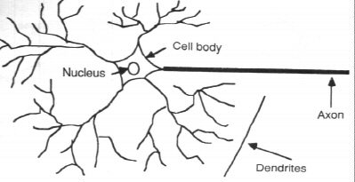
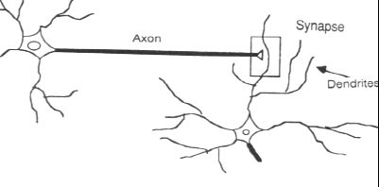
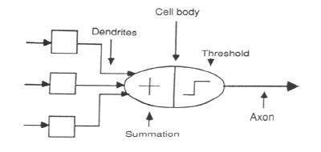
The Human Neuron Model

Slide 3
Neural Networks are similar to Biological Nervous Systems. They are:
1. a means to process inputed information
2. using a large number of highly interconneted proccessing nodes
3. to produce a best estimate of an outcome
4. that is most like (least different from) an input.

Slide 4
Basic Machine Learning Model
Input
Links
Output
Links
Input Function
Process
Function
ActivationFunction
Output
Function

Slide 5
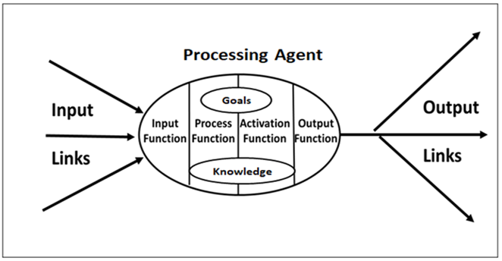

Slide 6
Neural Networks are not intended as general processing machine, but are configured as 1. a specific application 2. addressing a specific problem.
a) Pattern Recognition, b) Data Classification, c) Object Labeling.
Neural Networks are trained to identify correctly a large nunber of training data.
Subseqently, trained neural networks can adjust their connections and nodes to learn better solutions as they observe and attempt to match live data from a working environment.

Slide 7
The Structure of Knowledge
It is important to view knowledge as sort of a semantic tree.
Make sure you understand the fundamental principles (the structure of knowledge) , ie the trunk and big branches, before you get into the leaves/details or there is nothing for them to hang on to.

Slide 8
Machine Learning
1. Supervised Learning- labeled Training Data
2. Unsupervised Learning- Unlabeled Training Data
3. Neural Networks- Process with Multiple Layers
4. Convoluted Neural Networks- correctly Labeled Images and Error Adjustment

Slide 9
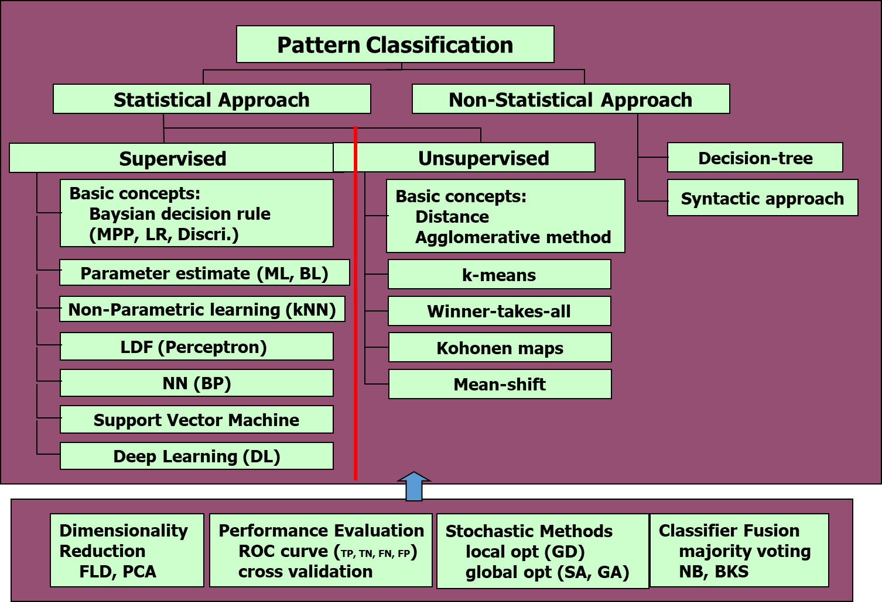

Slide 10
Supervised Learning

Slide 11
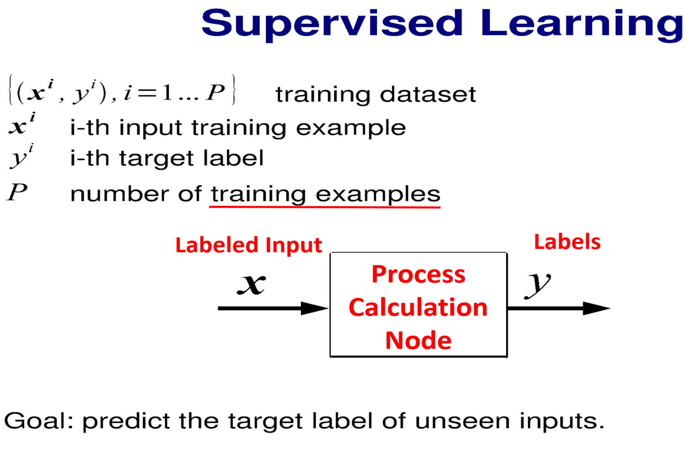

Slide 12
2 Tasks of Supervised learning- Regression and Classification
Regression : Predicts a continuous Target (Problem) Variable (Y) based upon inputted independent Data variables X1, X2, X3, ---.
Y= constant + b₁X₁ +b₂X₂ + b₃X₃, ------+ Remainder.
2. Classification: Assign a Label (Dog) or (Rita) to an inputed image or person in a Group Picture, or a specific Location or Object.
3. Labeled Training Sets used to Train and Correct the Identification System.

Slide 13
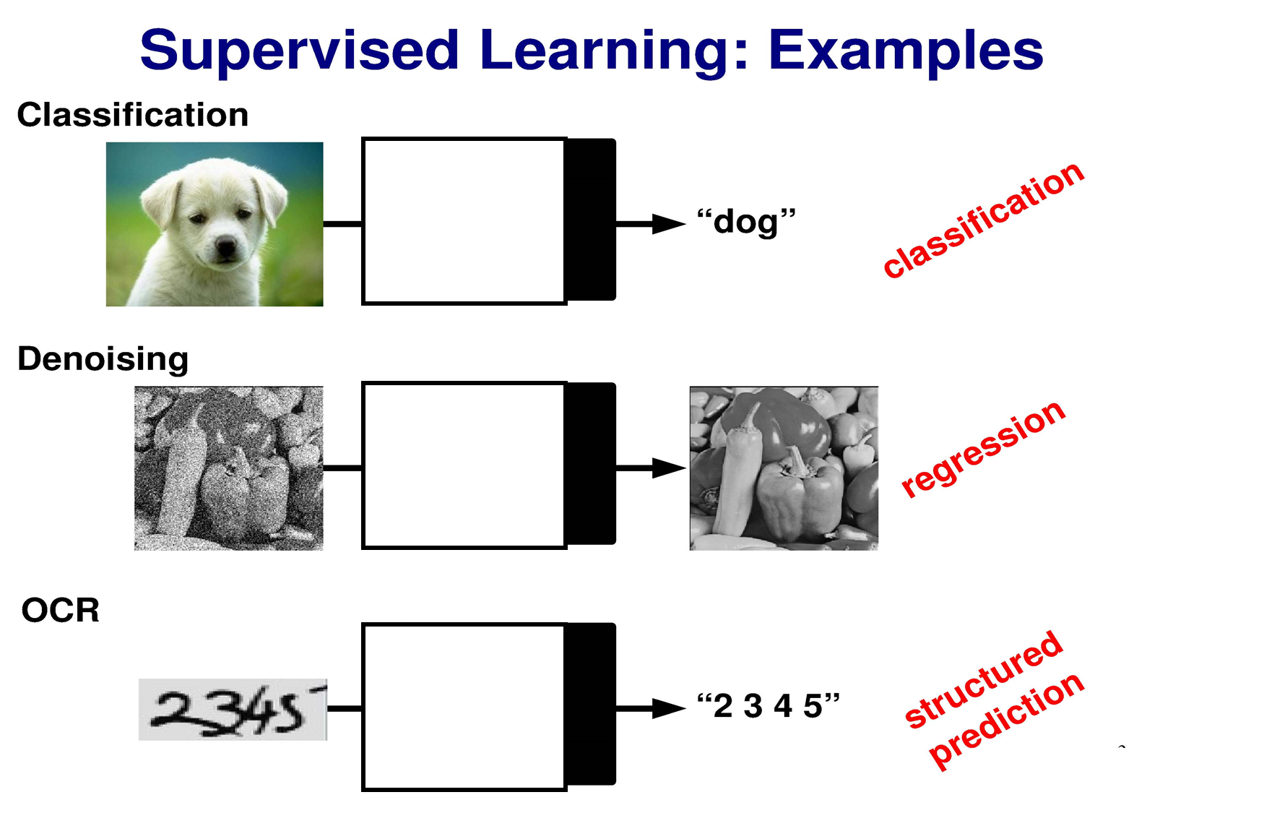

Slide 14
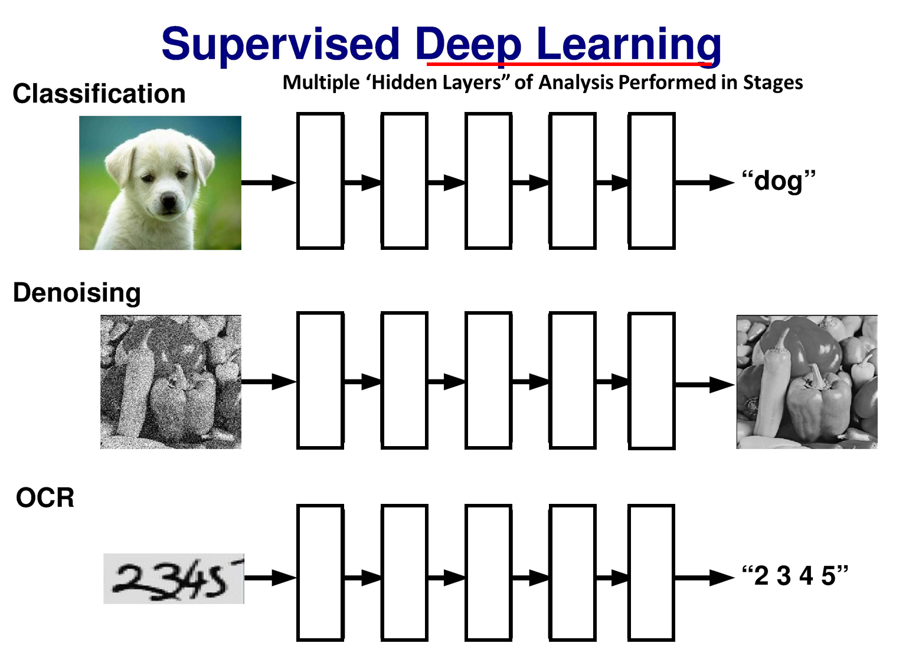

Slide 15


Slide 16
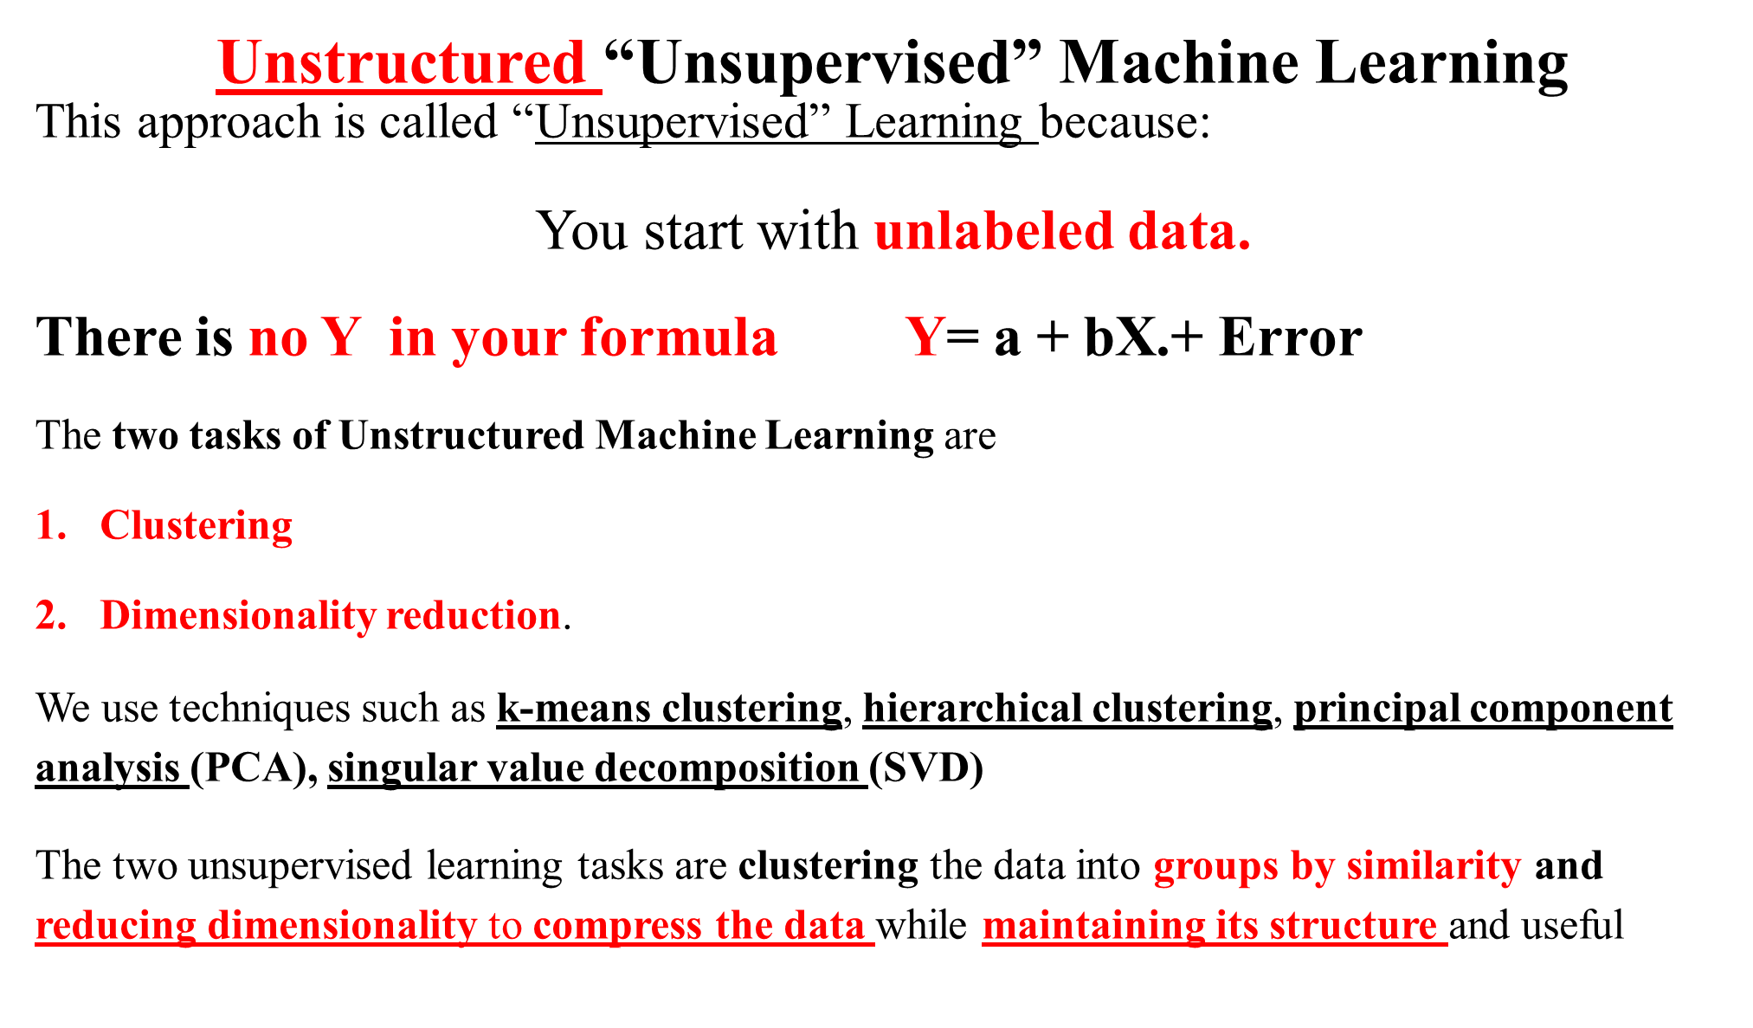
Into Similarity Groupings
While keeping the Structure of the Data

Slide 17
Problems Commonly Addressed in Unsupervised Machine Learning are:
1. How do you find the underlying structure of a dataset?
2. How do you summarize it and group it most usefully?
3. How do you effectively represent data in a compressed format?
This is called “unsupervised” because you start with unlabeled data(there’s no Y). Only X₁, X₂, X₃,-----

Slide 18
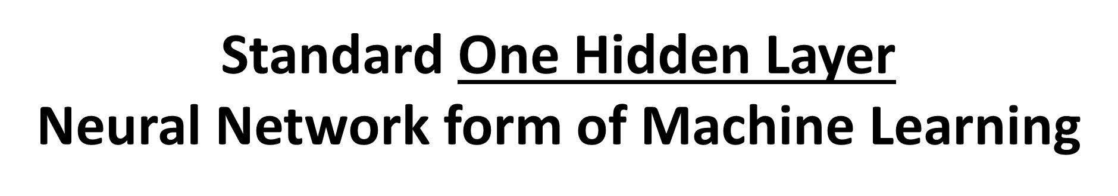

Slide 19
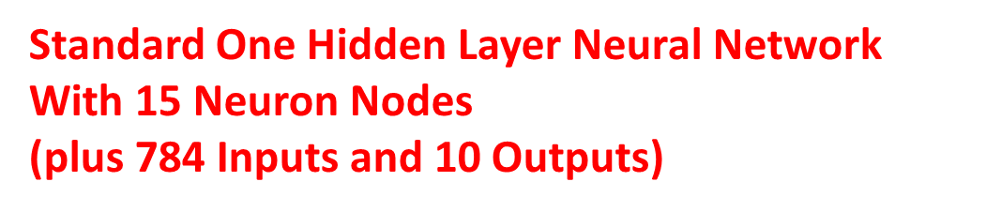
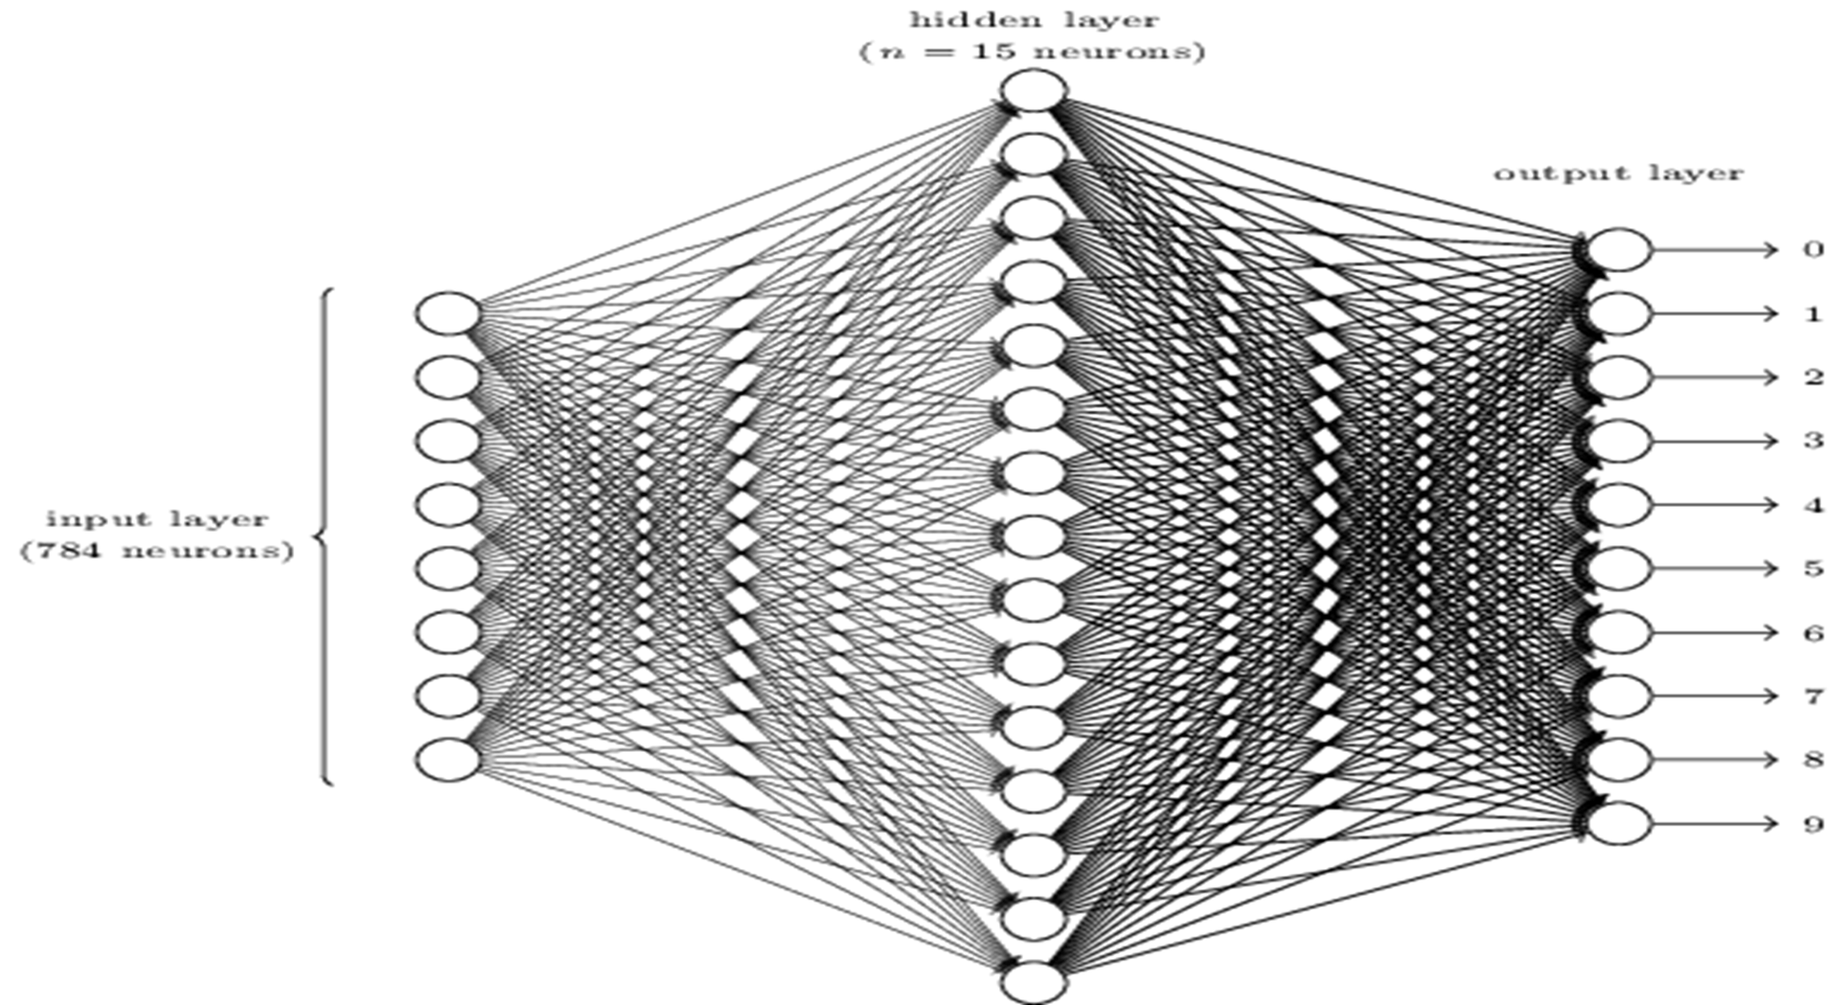
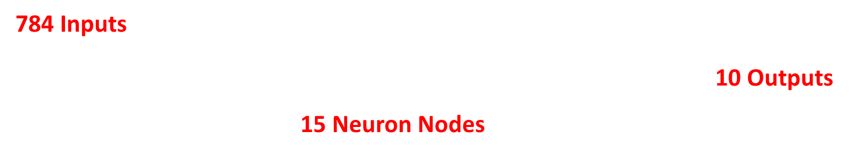

Slide 20
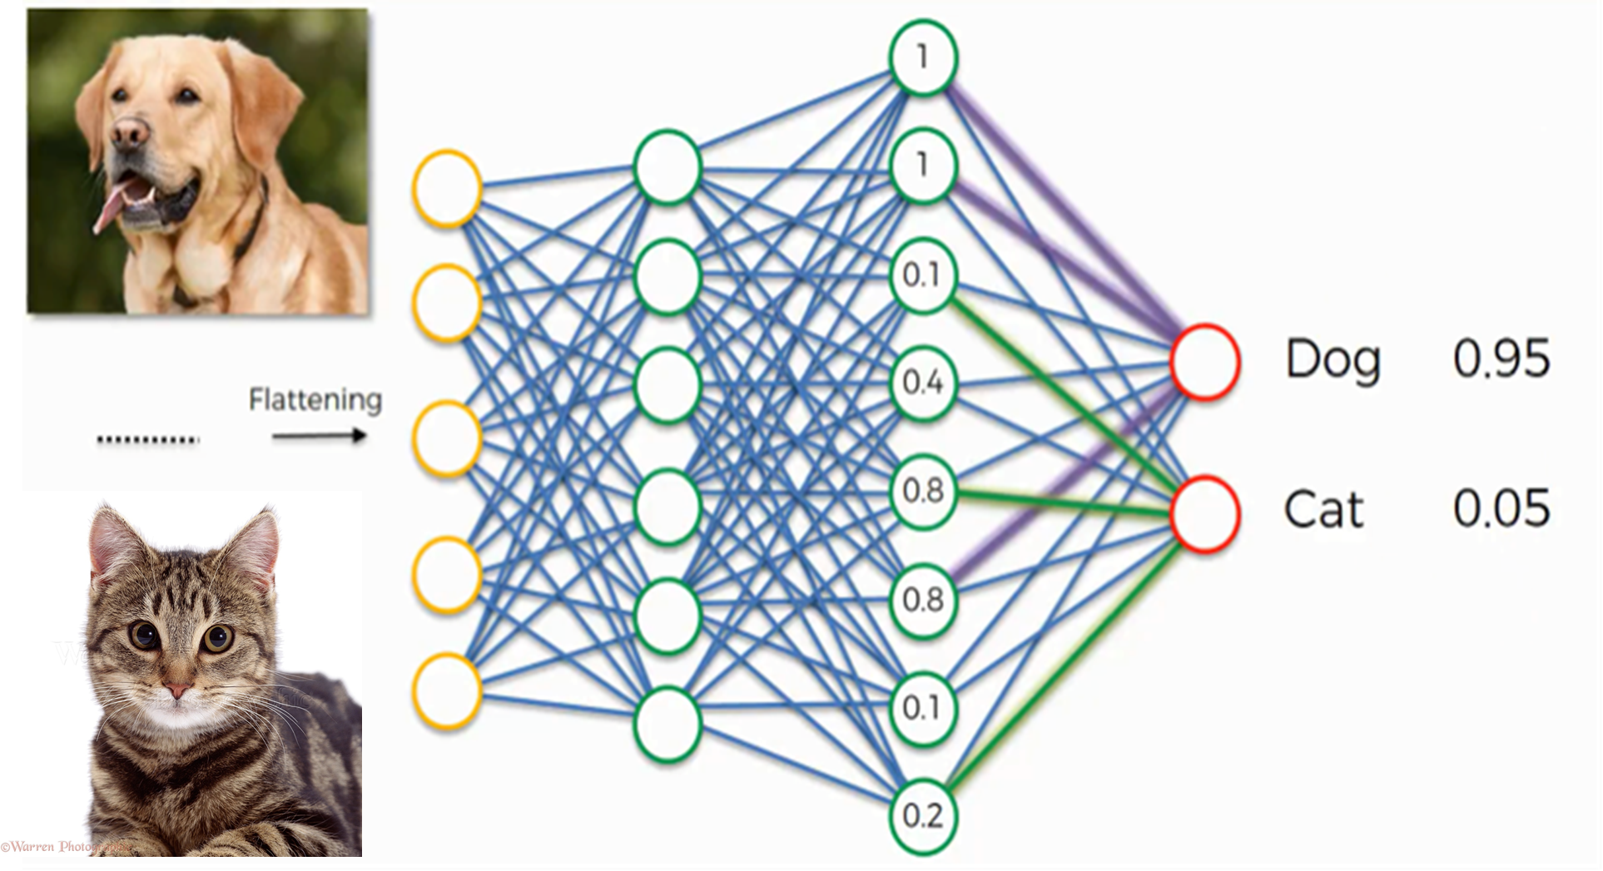

Slide 21
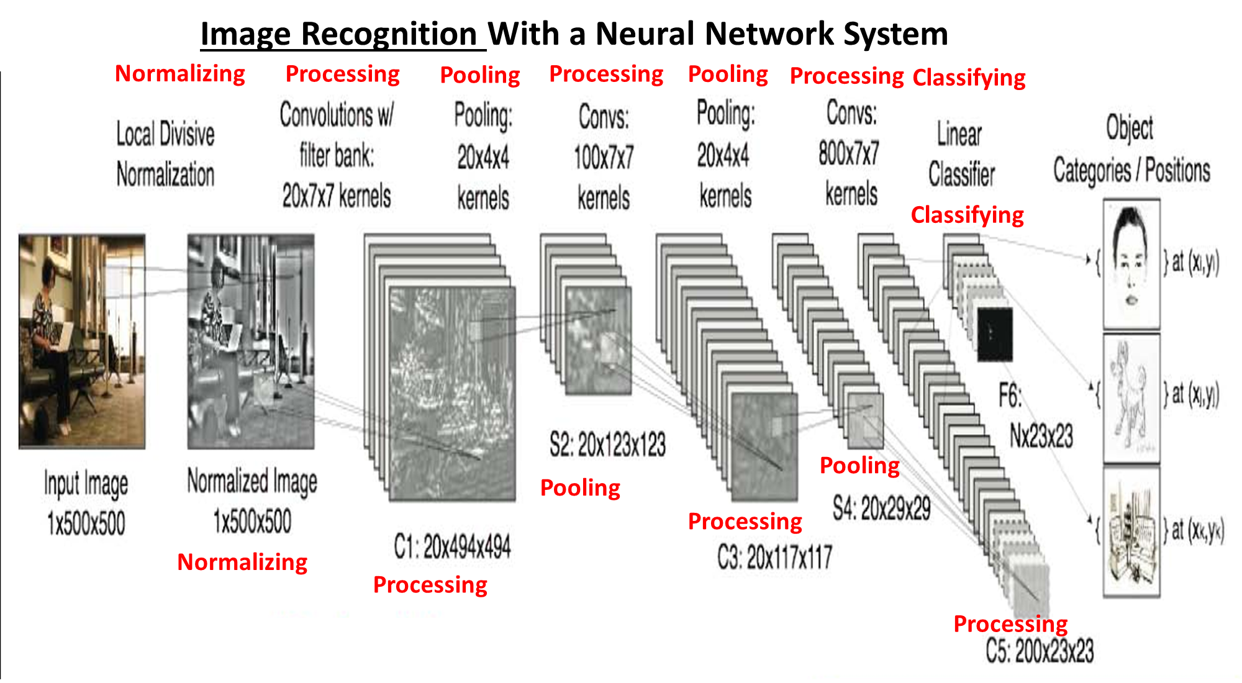

Slide 22
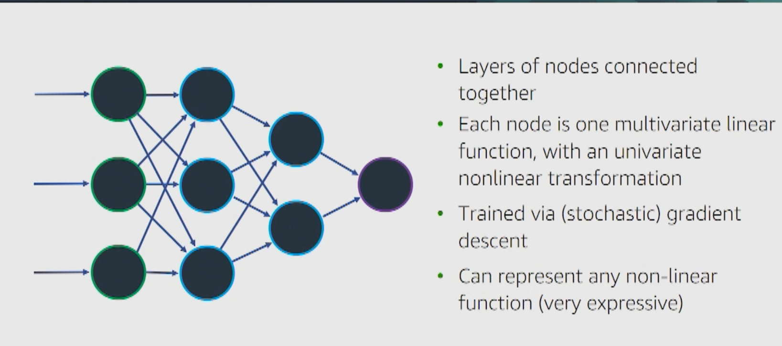
Neural Networks

Slide 23
1. The Number of Layers can be Large
2. The Number of Nodes in each Layer can be Large
3. Number of Inputs can be Much Larger
4. Training Data can be Large and of High Quality.

Slide 24
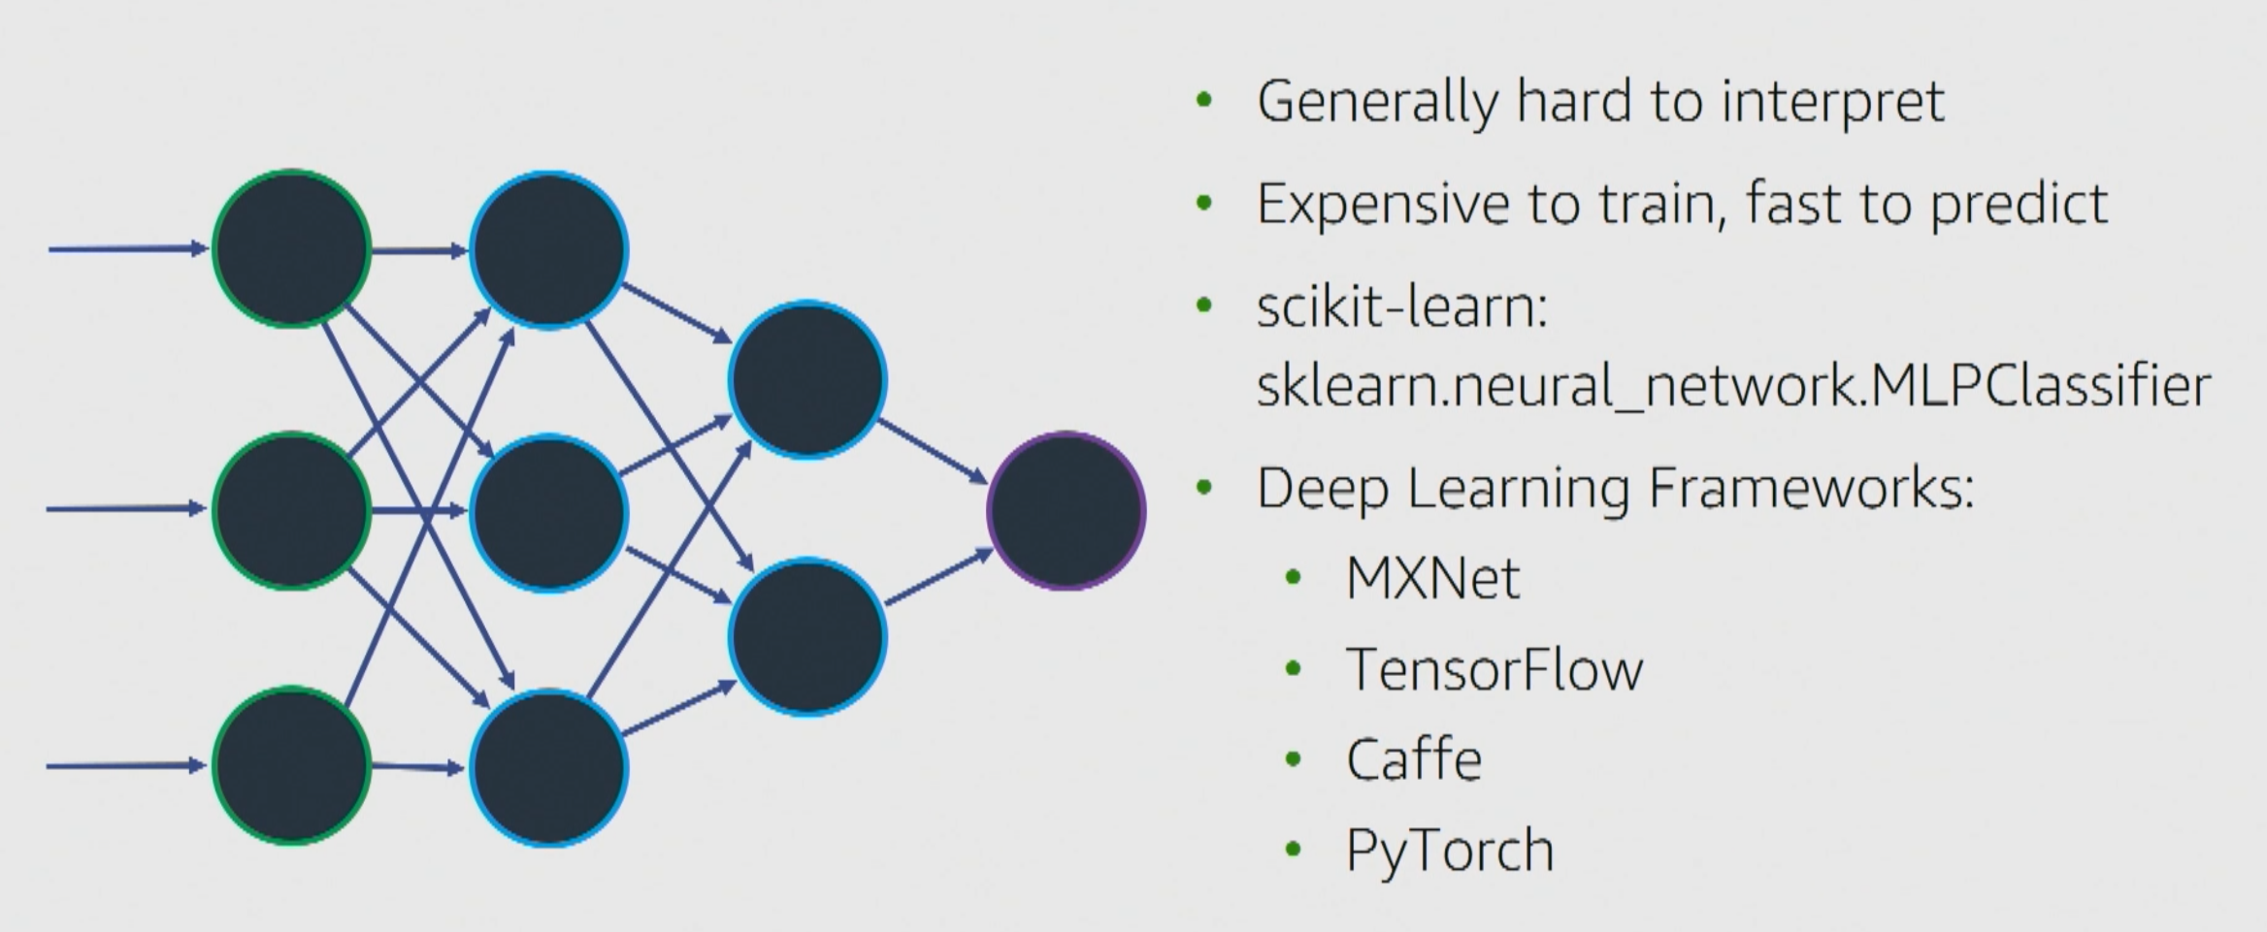
Because the Number of Layers can be Large & the Number of Nodes in each Layer can be Large, Number of Inputs can be Much Larger and Training Data can be Large and High Quality.
Has number of NN Frameworks to use to Learn with
Popular
Developed from Different Sources, but all can be accessed from Python

Slide 25
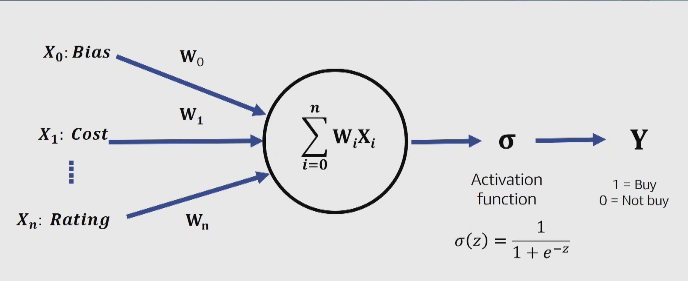
Components of a Neural Network System
Inputs
Affects
Weights
Calculations
Result - Outputed
Activation Function

Slide 26
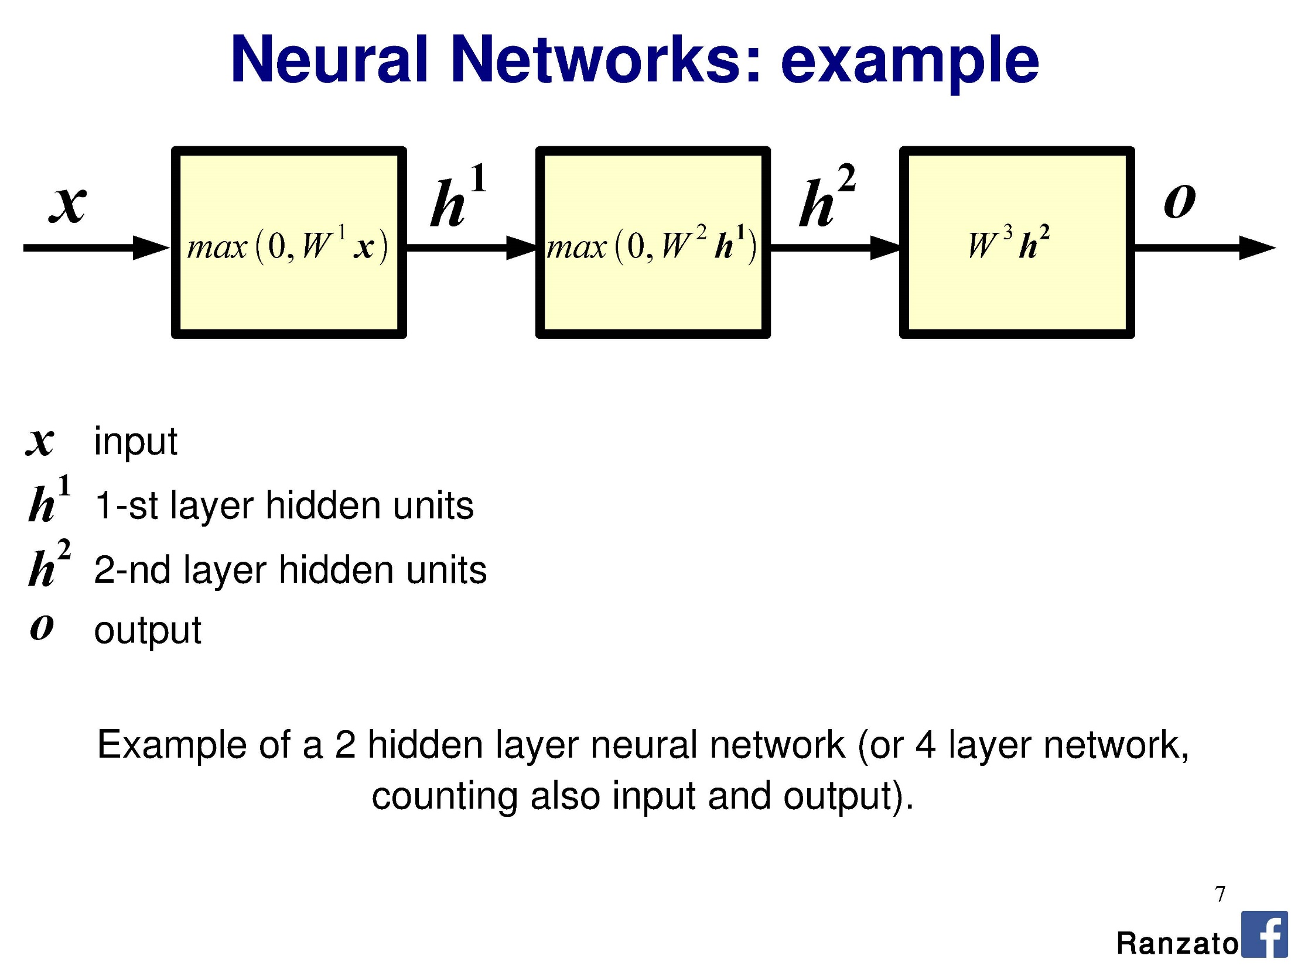
Process 1
Process 2
Process 3
Inputs
Output
Result
3
5

Slide 27
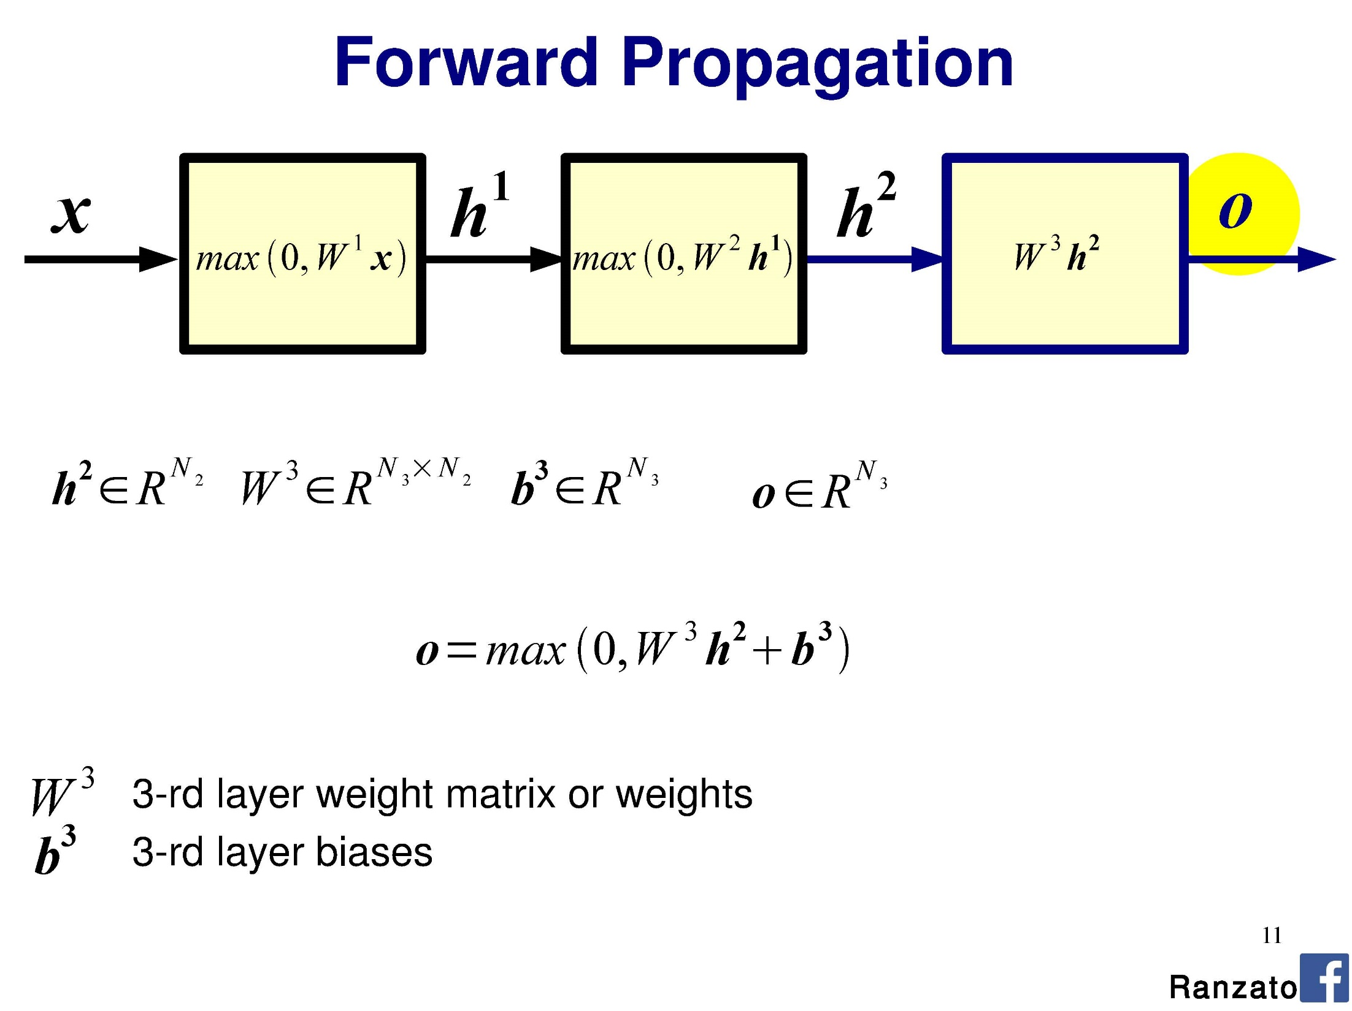
Feed-forward
Pick the Least Different Pattern from the Input Data
Identify the inputted pattern from the input data

Slide 28
Is it a Dog or a Cat?
95% chance it is a Dog

Slide 29
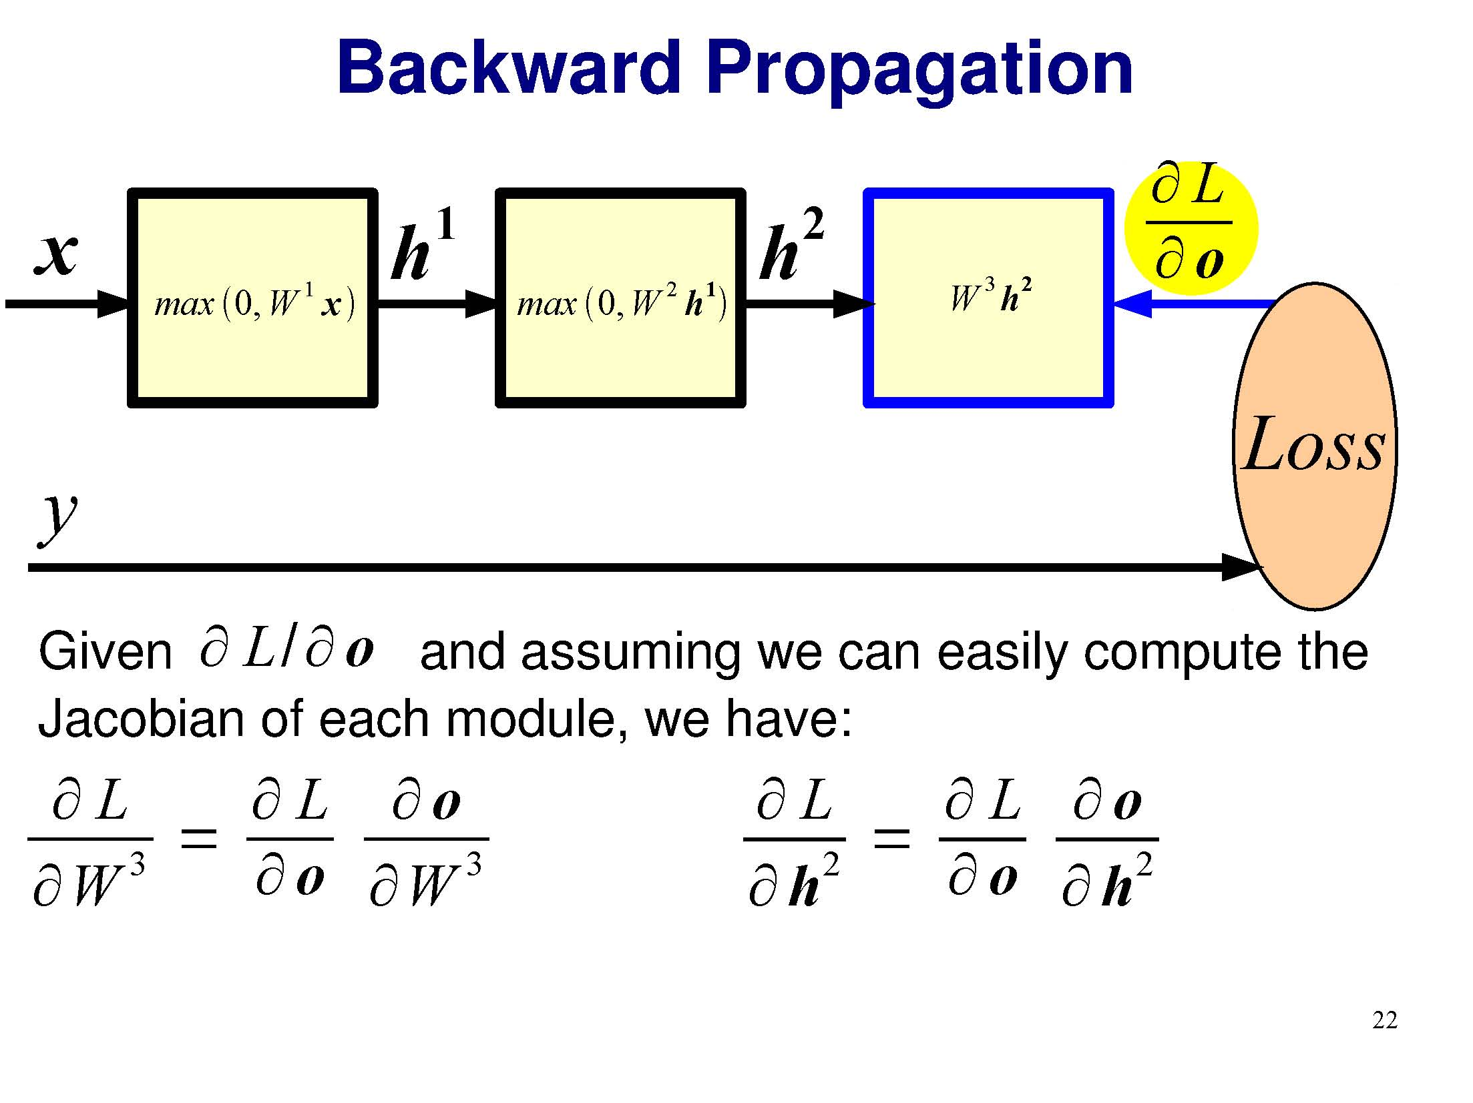
Error in the Output
Adjust Weights
Adjust Biases
Adjust Biases
Adjust Process
Adjust Process
Adjust Process
Backward adjust based upon the error in the output

Slide 30
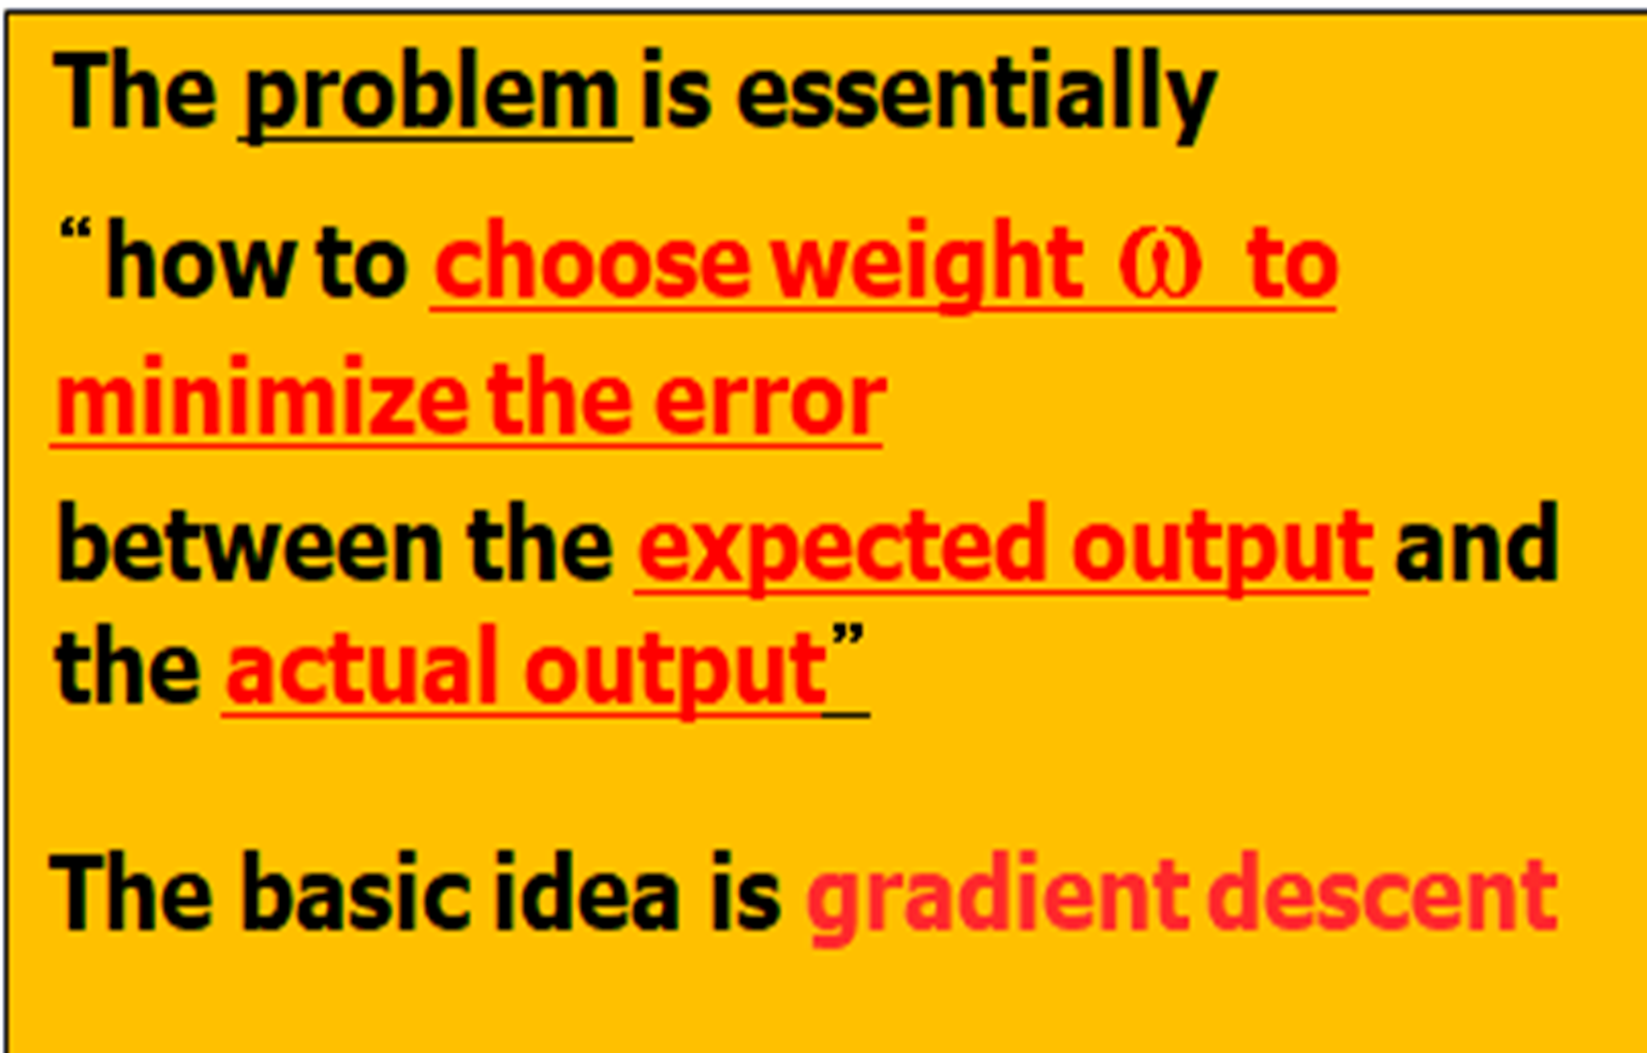

Slide 31
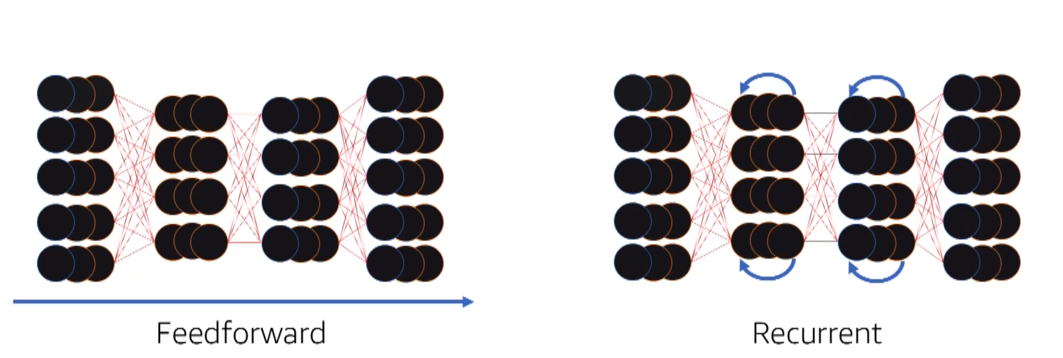
Two Types of Neural Networks
1. Feed Forward, no Backward Looping
2. Feed Forward + Backward Looping
Looping Backwards then Reprocess
Recurrant Feedforward and Backward Looping Neural Network
Feedforward Neural Network
Provides for Looping Backwards
Processing sequential information - Text, Speech, handwriting where ability to predict next work of letter is vastly improved if you know the word or letters that comes prior.
Data moves from one input to output without looping backwards

Slide 32
Unsupervised Learning

Slide 33
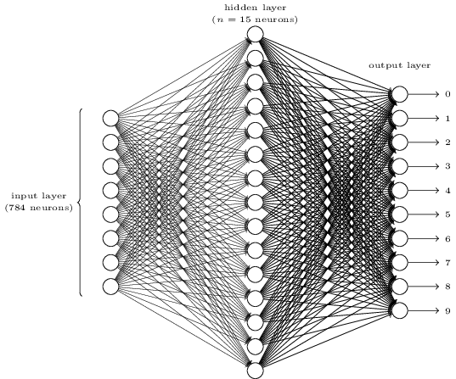
Neural Network Example – MNIST Image Recognition
Calculations
Links with Weights
Activation Function
Result - Outputed
Affects
Inputs
784 Inputs
10 possible Outputs
_{Image from: [Nielson]}
15 Neuron Calculators in Hidden Layer

Slide 34
Pattern Recognition vs. Pattern Classification
Feature
extraction
Pattern
classification
Recognition
result
Input
media
Feature
vector
Need Domain Knowledge
Need Prior Domain Knowledge
Classifies based on Training Images
Pattern Classification and Scene Analysis

Slide 35
Supervised vs. unsupervised
Parametric vs. non-parametric
Classification vs. regression vs. generation
Training set vs. test set vs. validation set
Cross-validation

Slide 36
Simplified Example
Two Hidden Layer Neural Network

Slide 37

Inputs
Hidden Internal Layers
Separately weighted Interconnections
Outputs
Forward Propagation

Slide 38
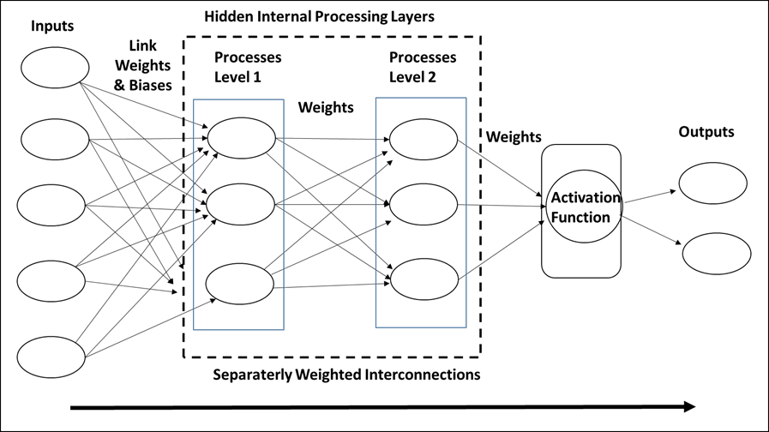

Slide 39
Each Processing Node in a Vertical Layer receives the Weighted, Biased input from all the input nodes.
In the Next Layer each Processing Node receives all the weighted output from all the preceding Layer Nodes

Slide 40
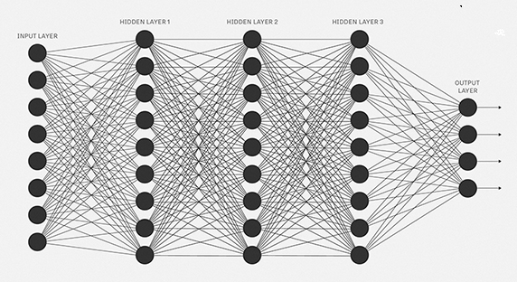
Deep Learning (3 Hidden Layers) Neural Network
Everything Connected to Everything

Slide 41
Important Neural Network Design Issue
1 How many separate Processing Layers 1, 2, or 3, --- (Vertical Stripes of nodes)
2. How many Processing Neuron Nodes in each Processing Layer (stripe)
3. What weights, biases, and affects, to use on each input link
4. What weights to put on each inter-Node link
6. What weights or to apply to each output link
7. What Activation Function to employ against outputs. “0 or 1” “Dog vs Cat”

Slide 42
Convolutional Neural Networks
One of Primary Usages
Images Recognition
Faces, Objects, Written Letters
Scene Analysis

Slide 43
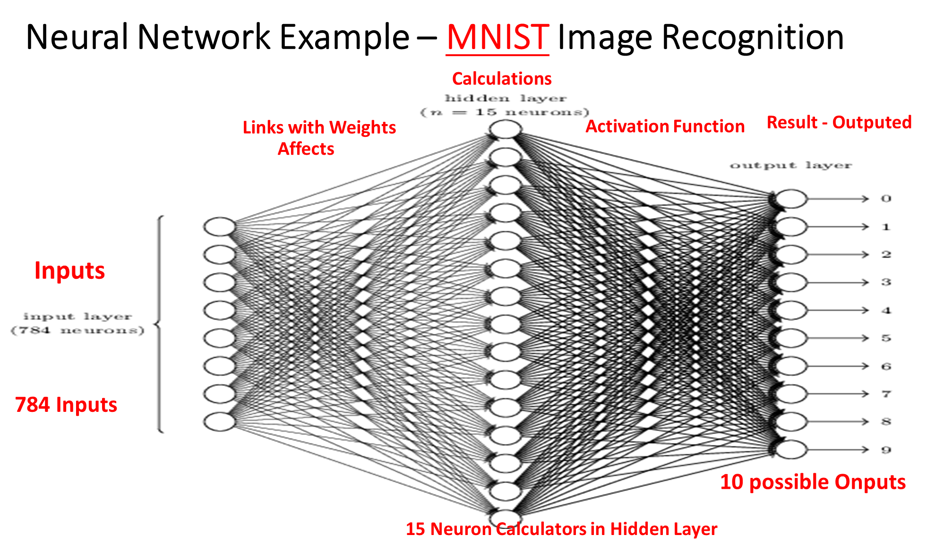

Slide 44
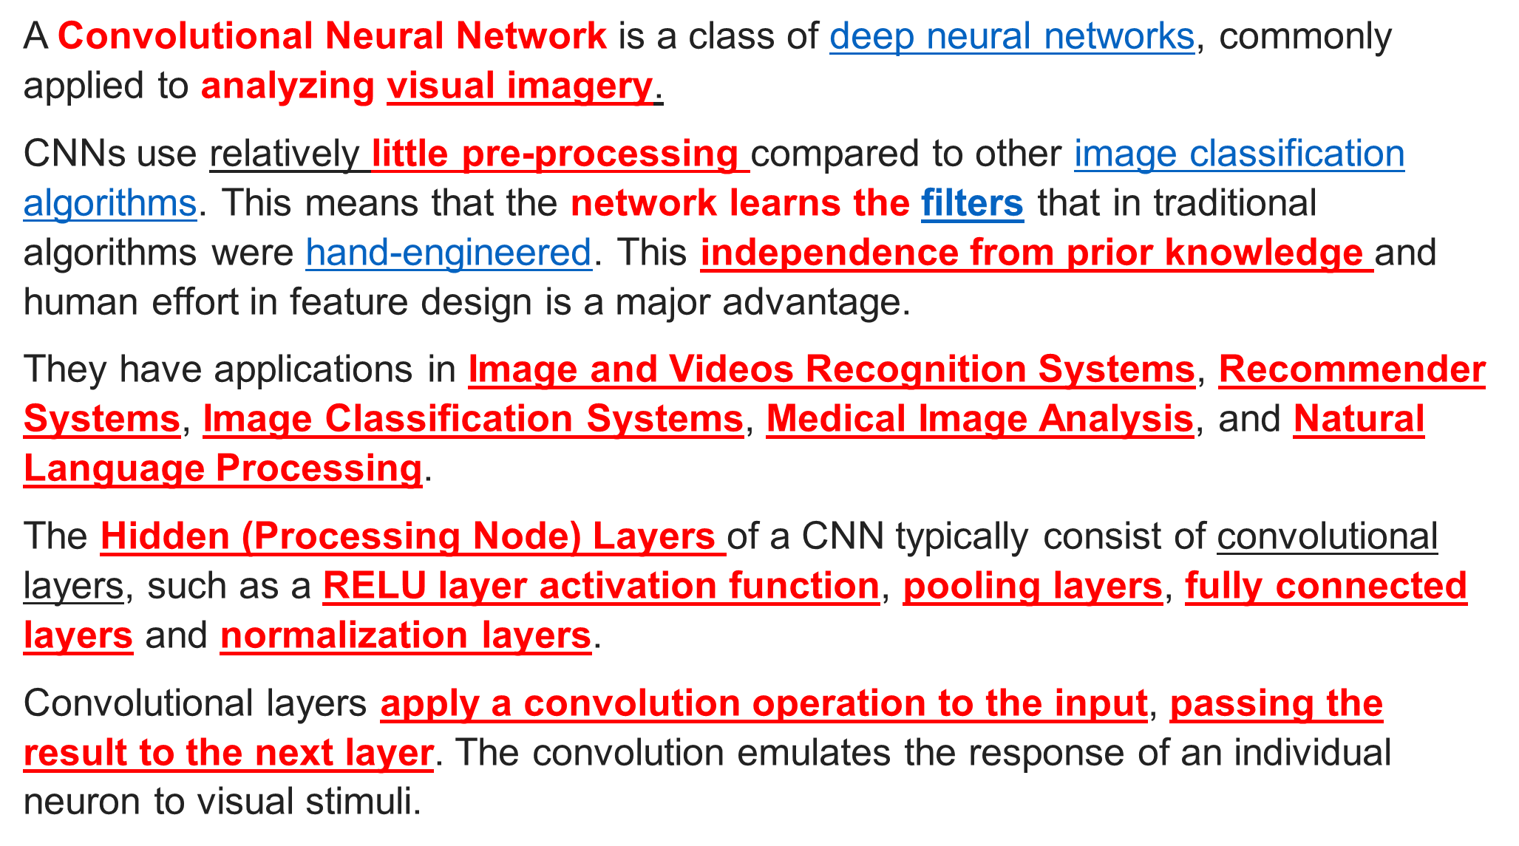

Slide 45
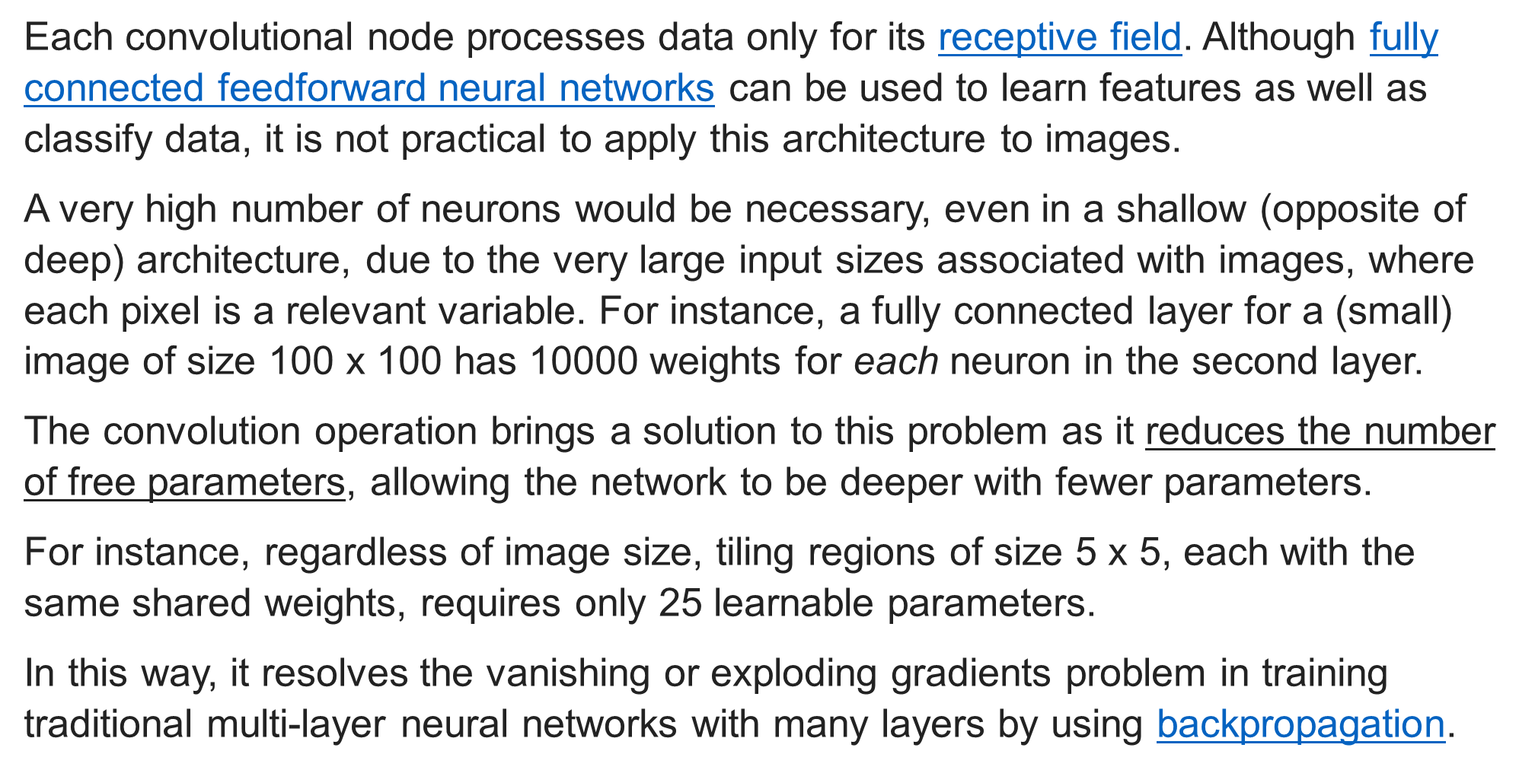

Slide 46
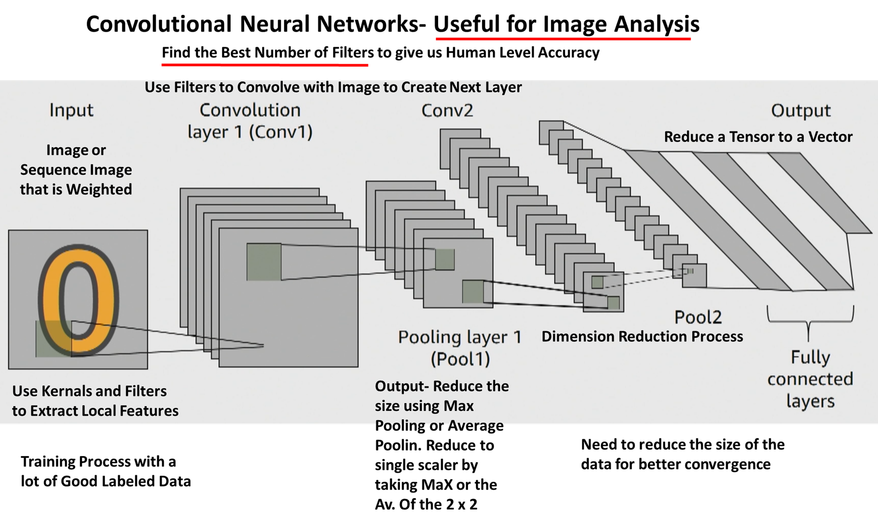

Block of Local Pixels
Reduce Size

Slide 47
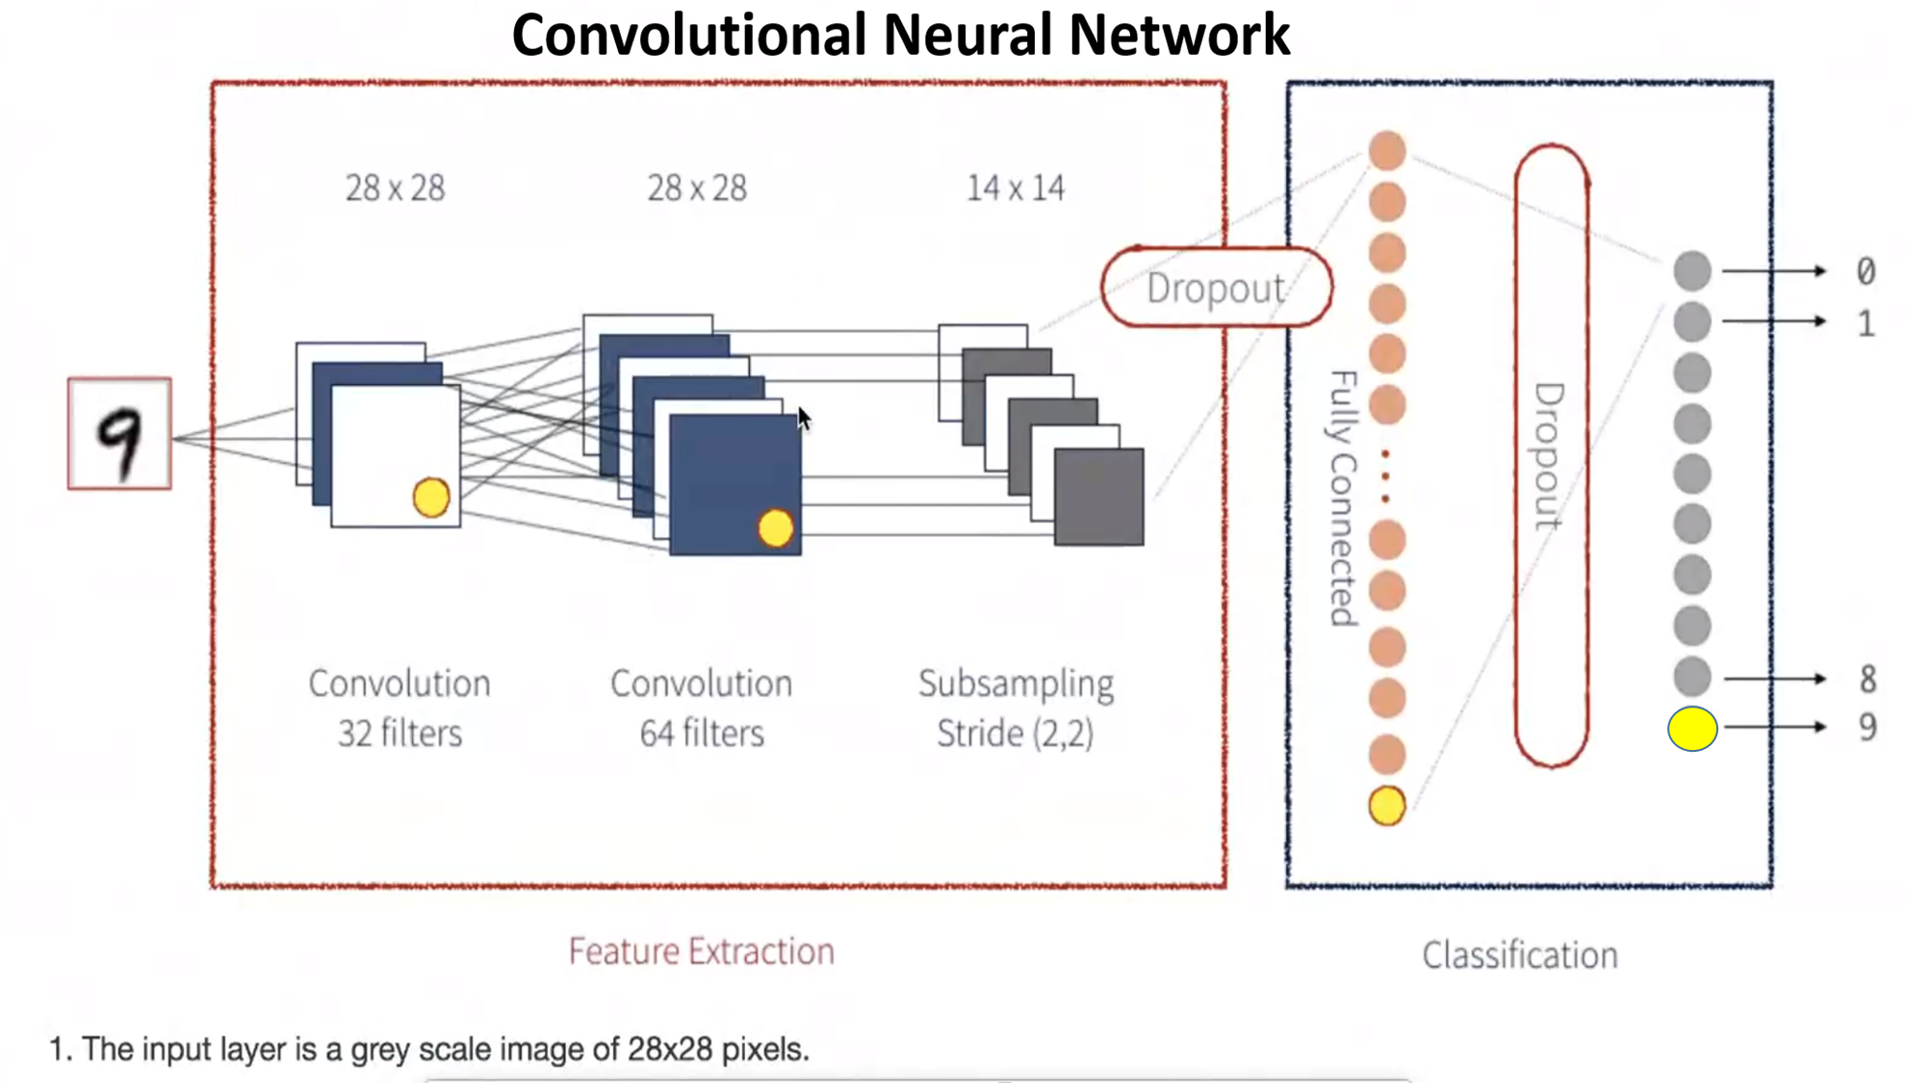
Drop Outs
32 Filters
64 Filters
Sampling

Slide 48
Process of Facial Recognition
Shapes, Planes and Lines
Shadings and Luminosity
Distinguishing Points

Slide 49
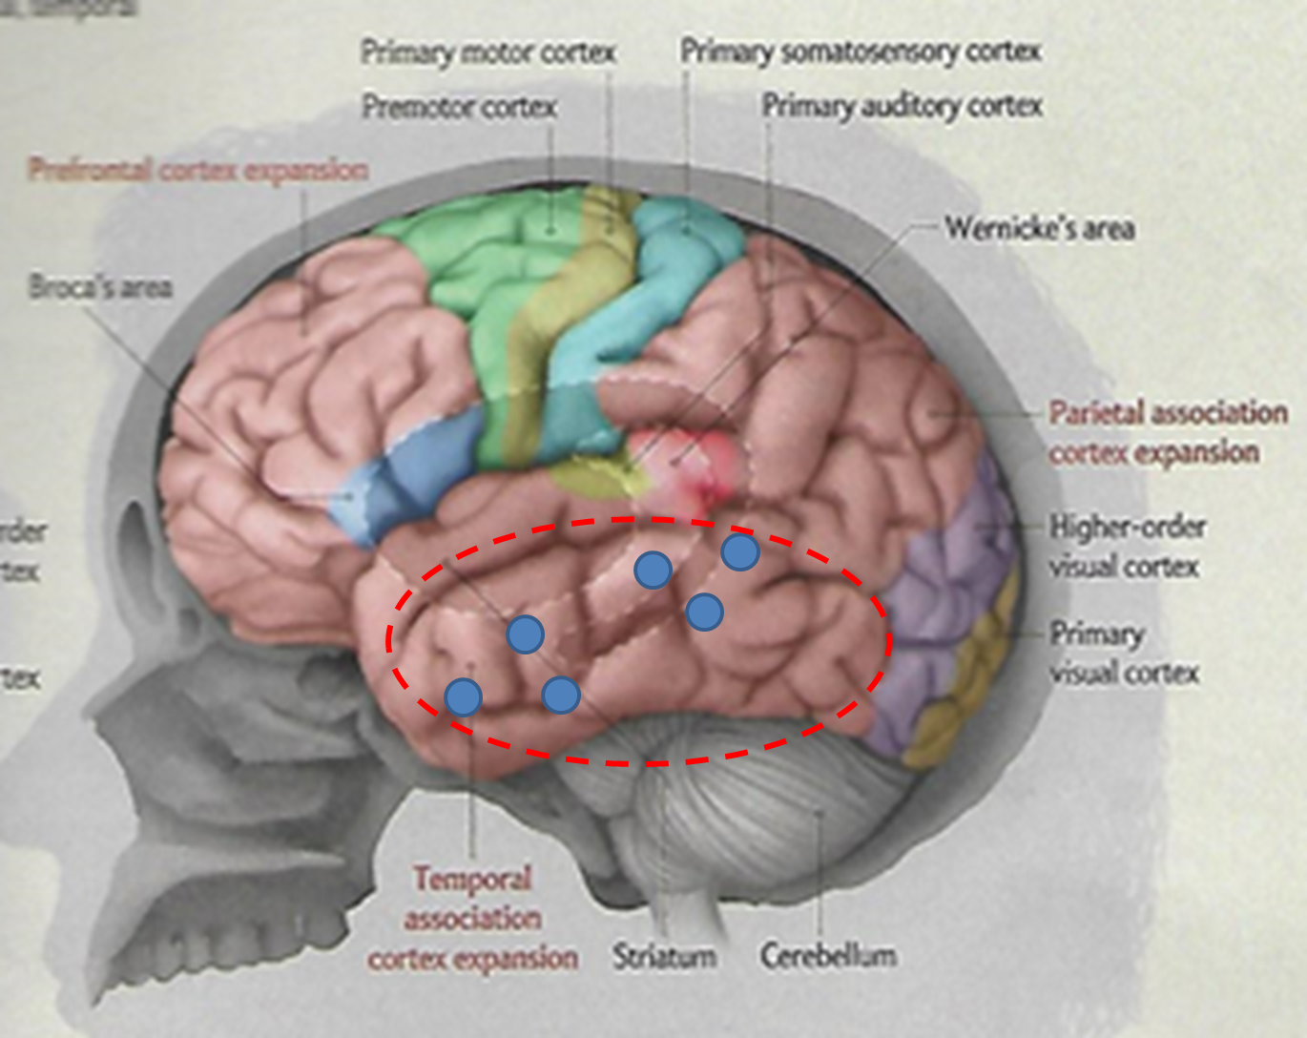

Slide 50
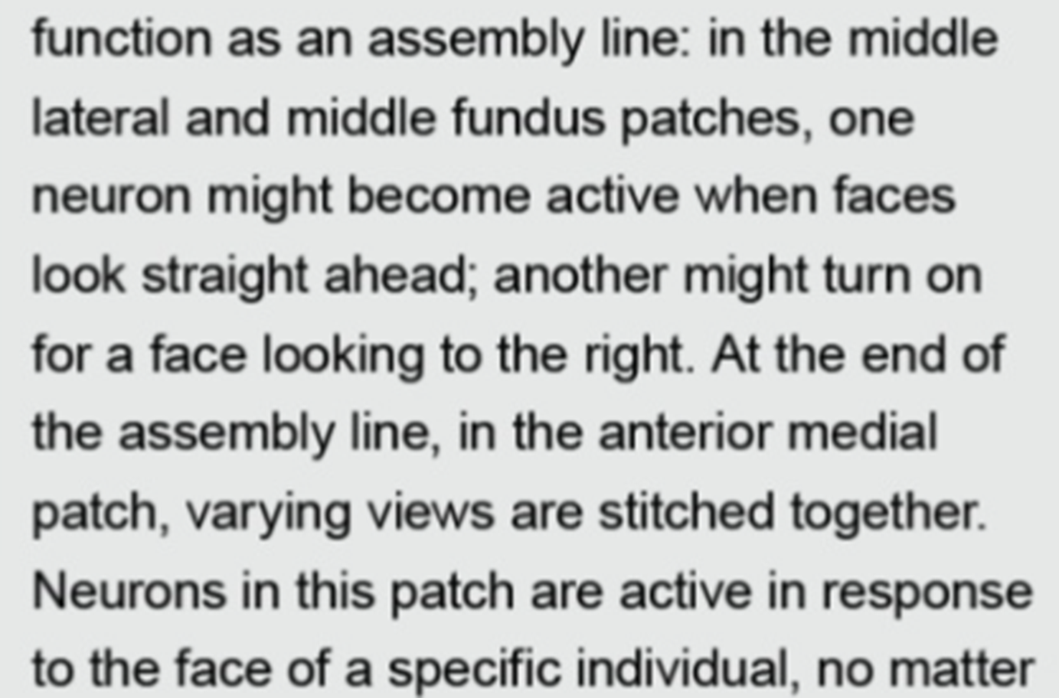

Slide 51
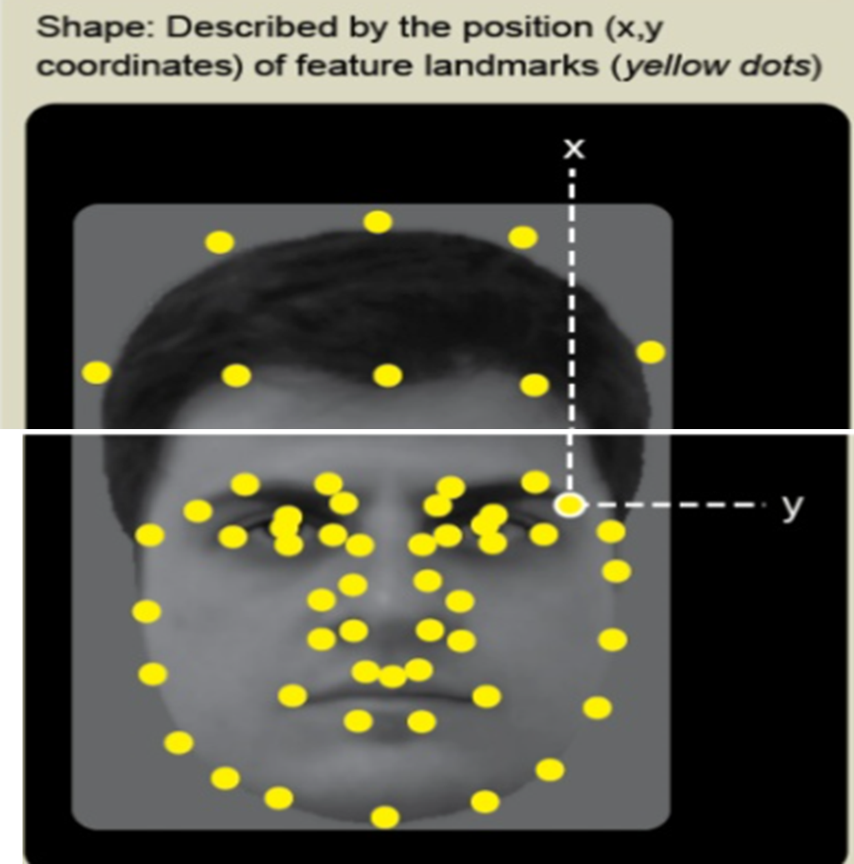

Slide 52
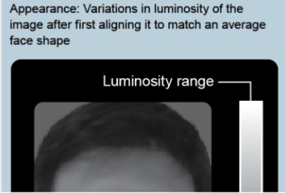
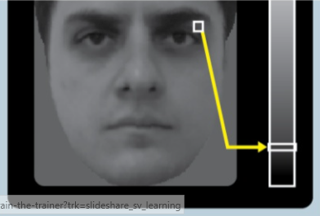

Slide 53
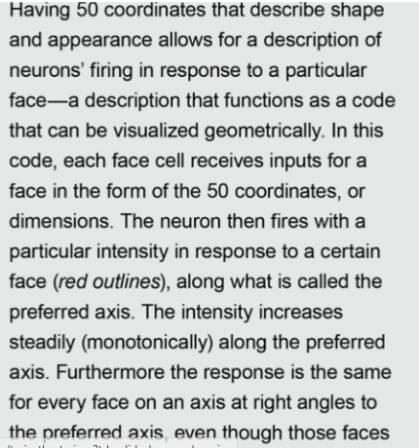

Slide 54


Slide 55
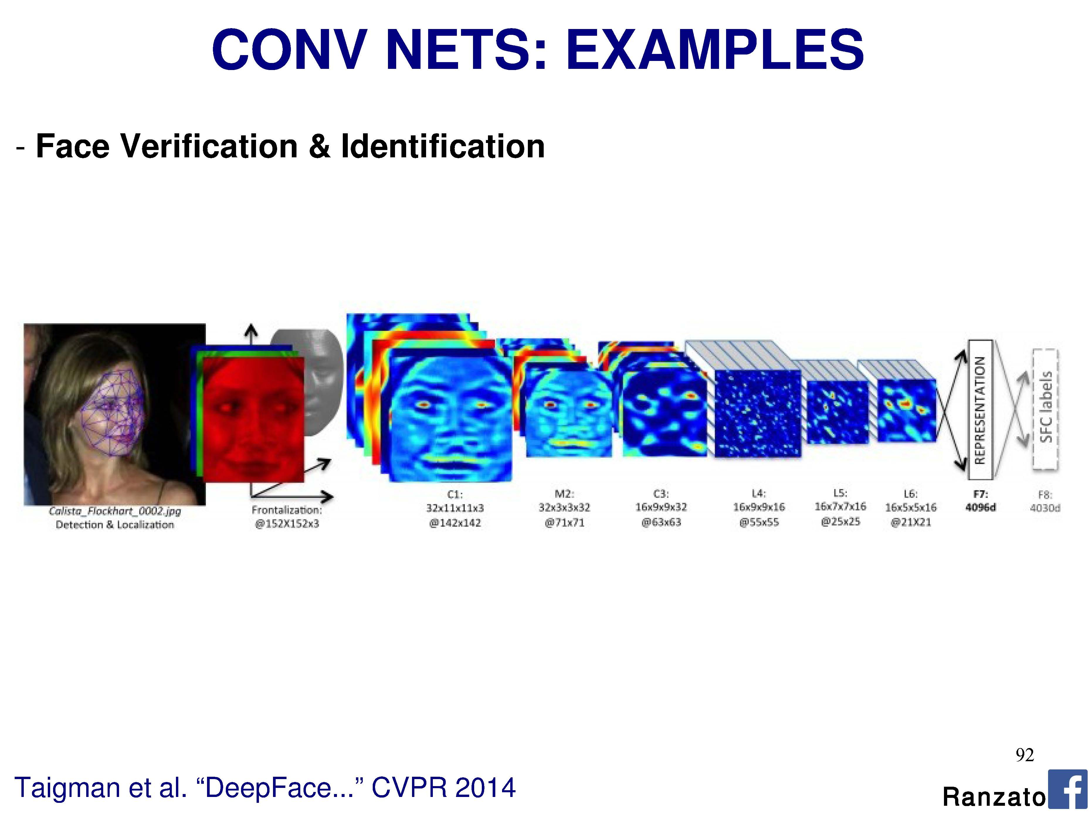
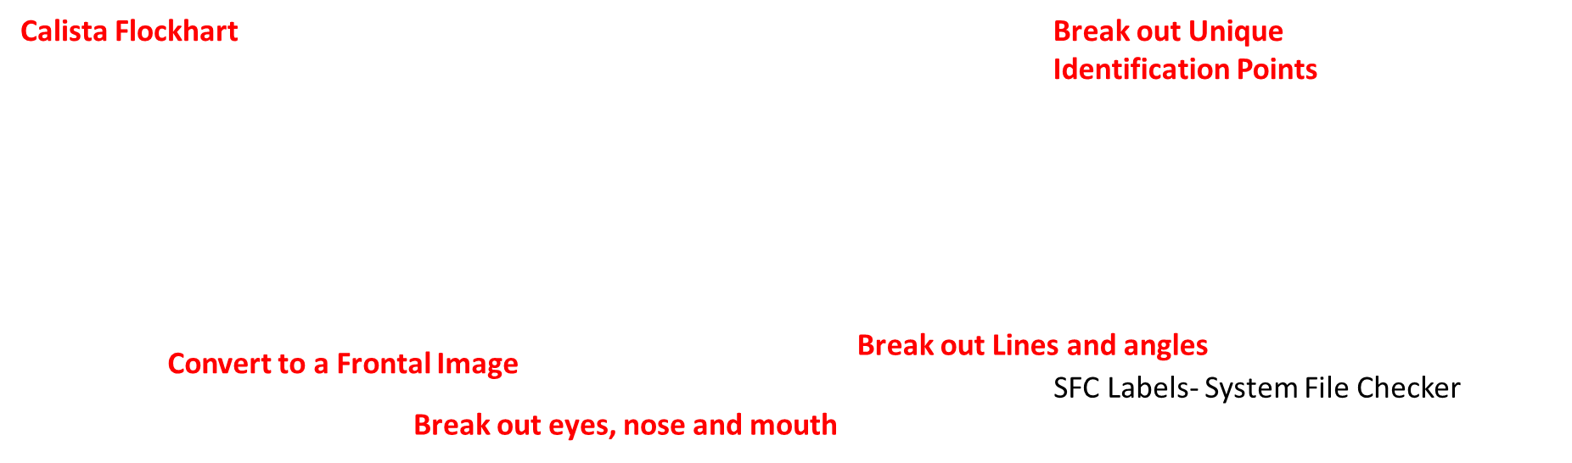
Convolutional Neural Network Examples
SFC Labels- System File Checker

Slide 56
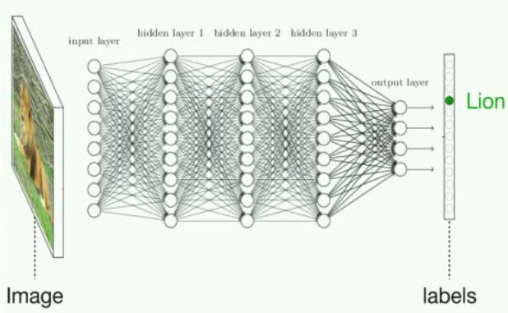

The Correct Label
S
Input
Output

Slide 57

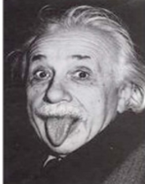
The Correct Label
Other Incorrect Labels
S
Input
Output

Slide 58
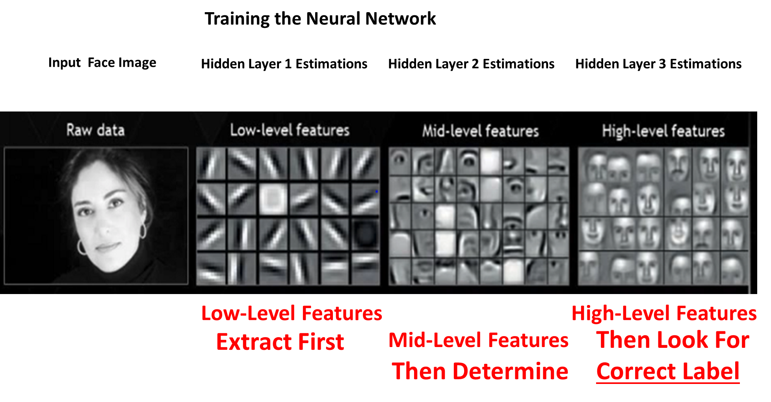

Slide 59
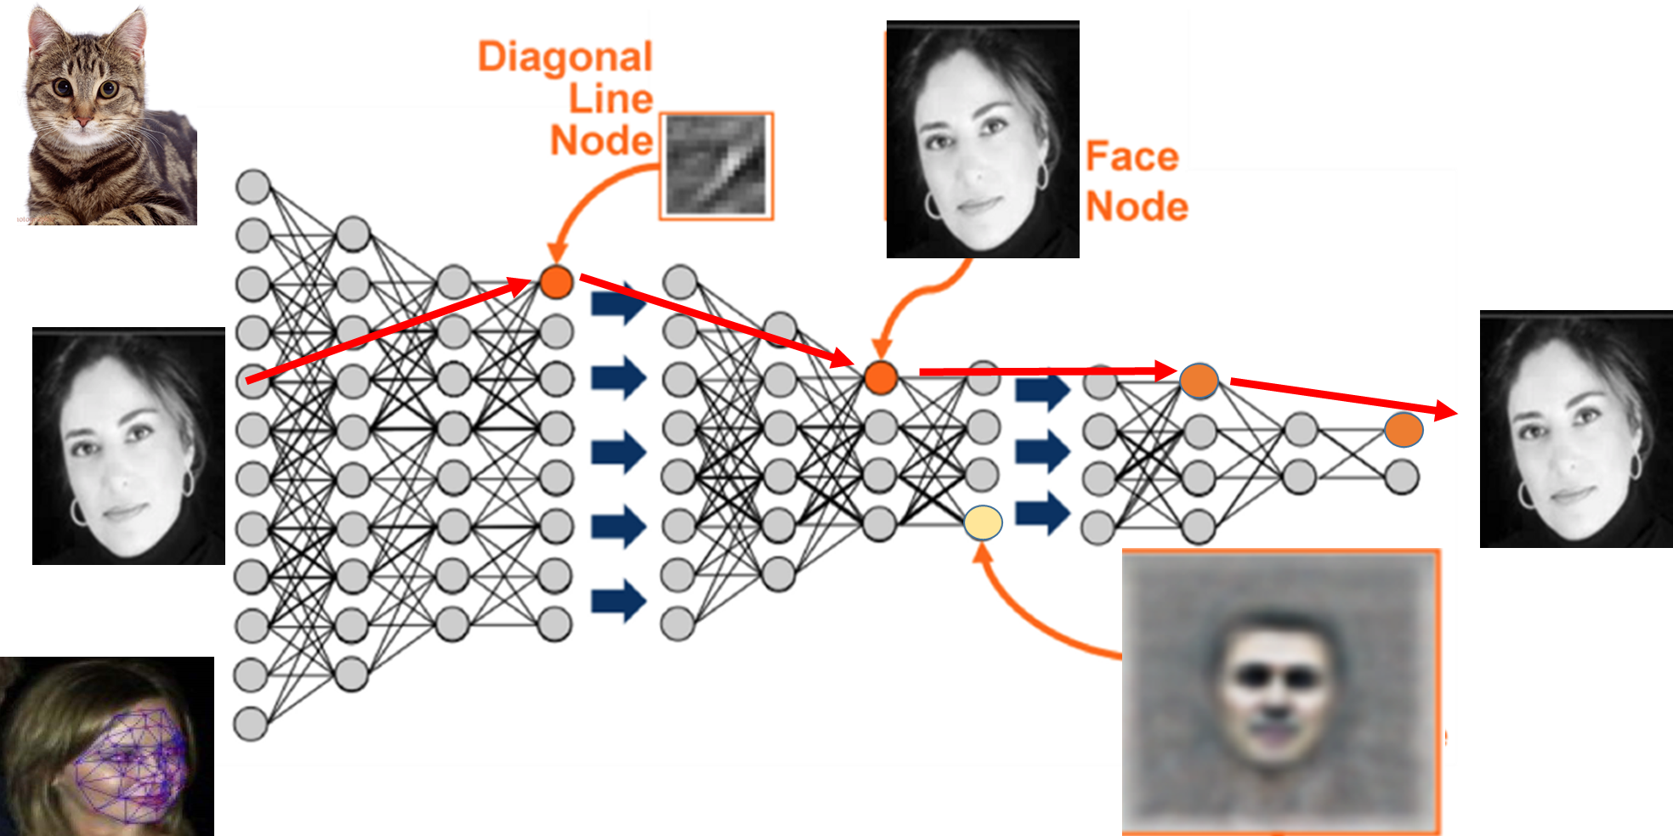

Slide 60
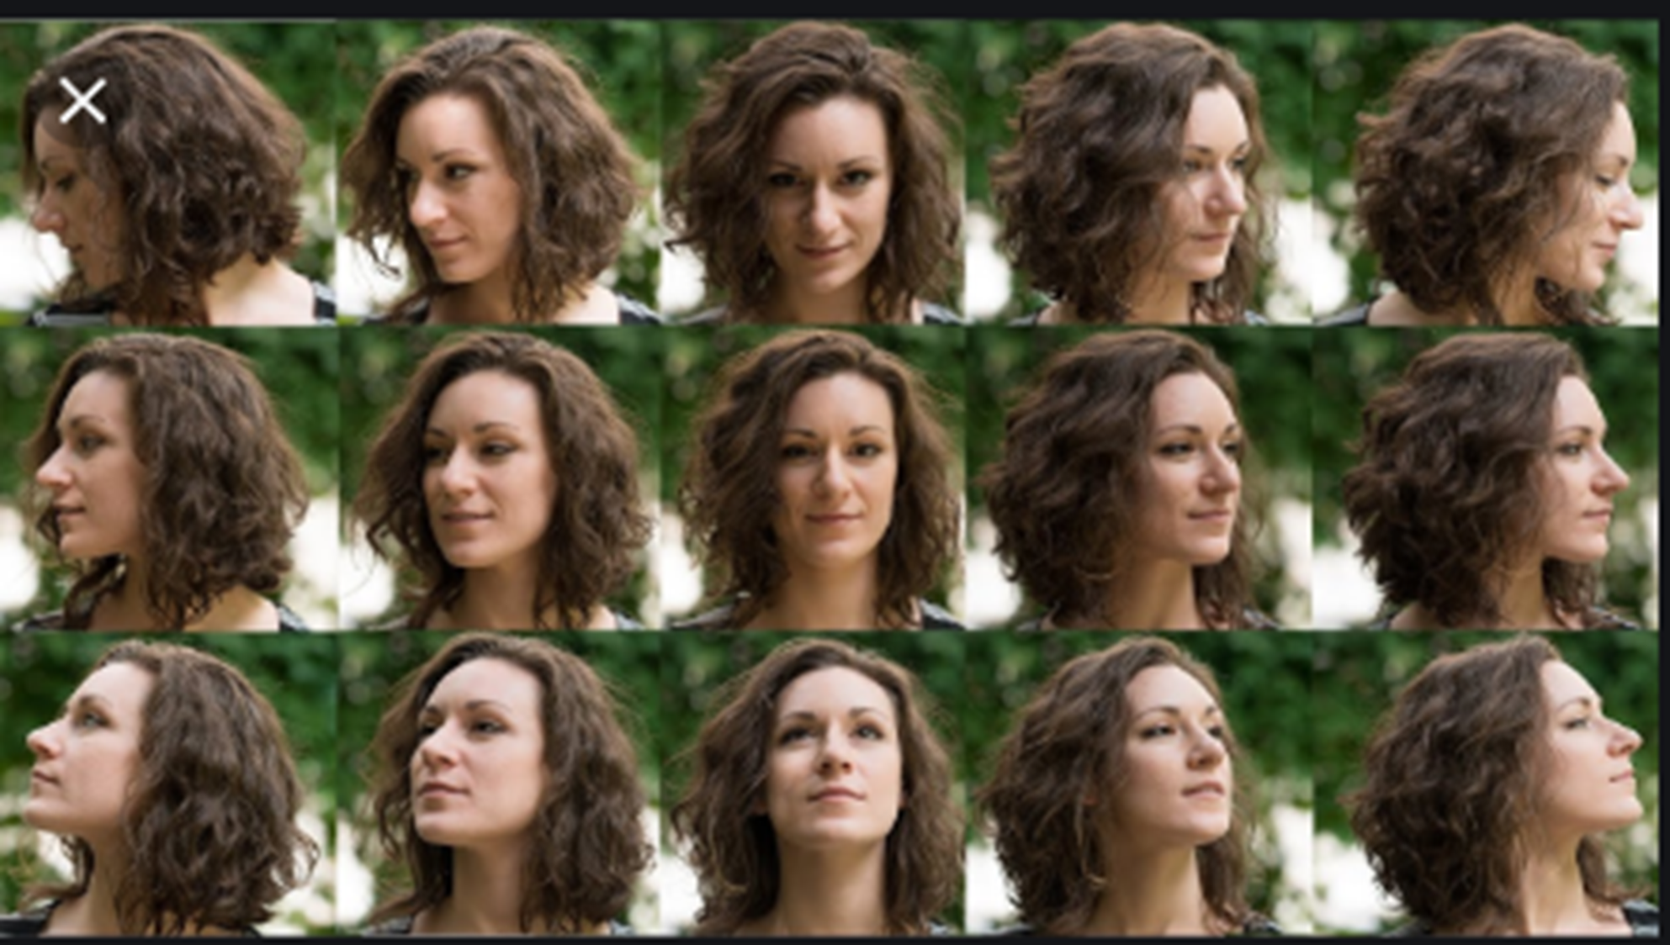

Slide 61

Convert any Angle of Picture to Frontal

Slide 62
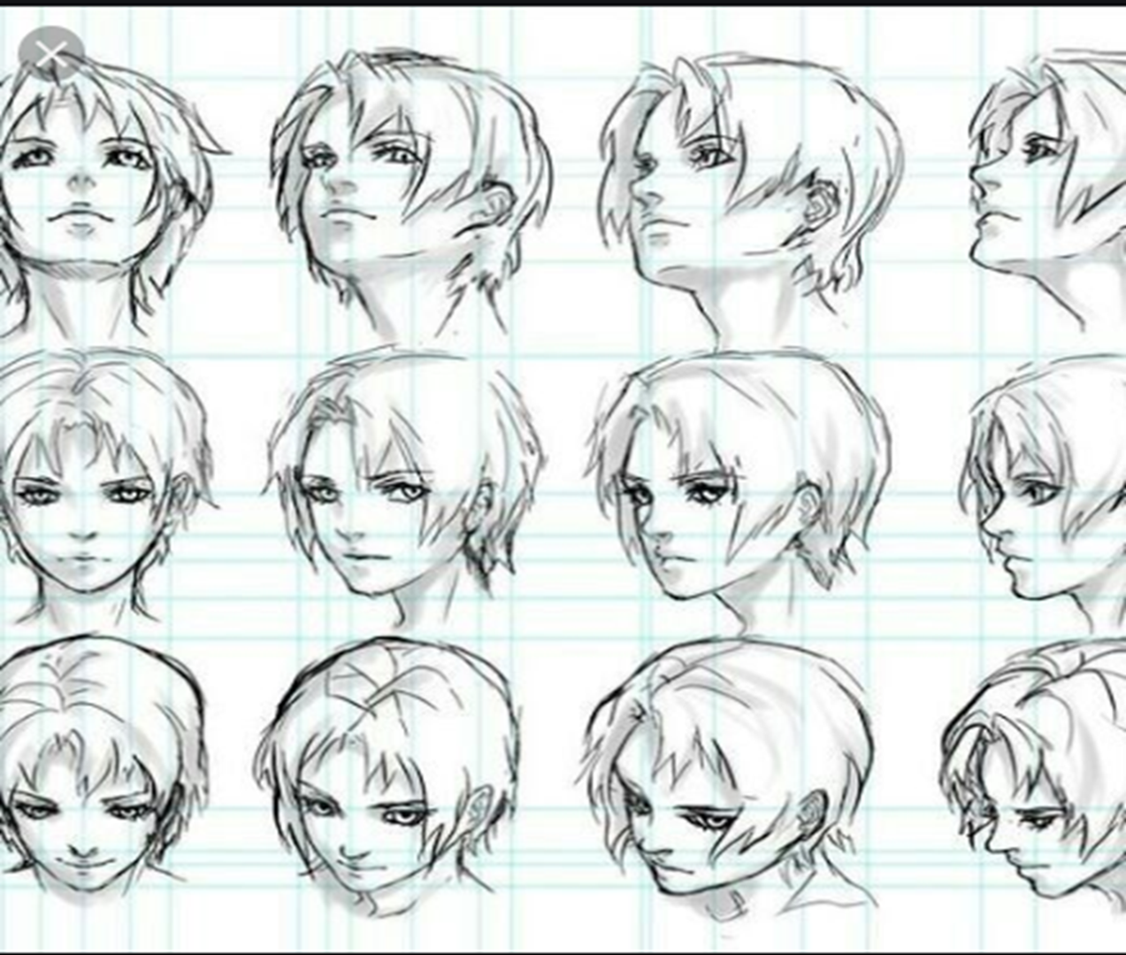

Slide 63
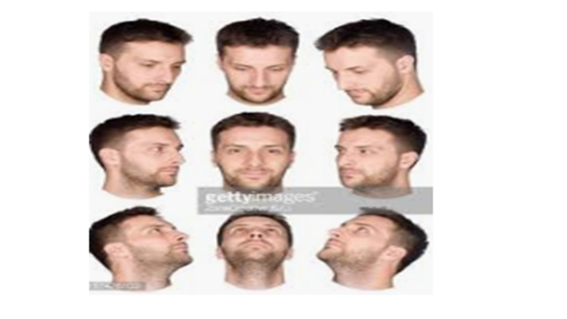
Convert to Frontal Image

Slide 64
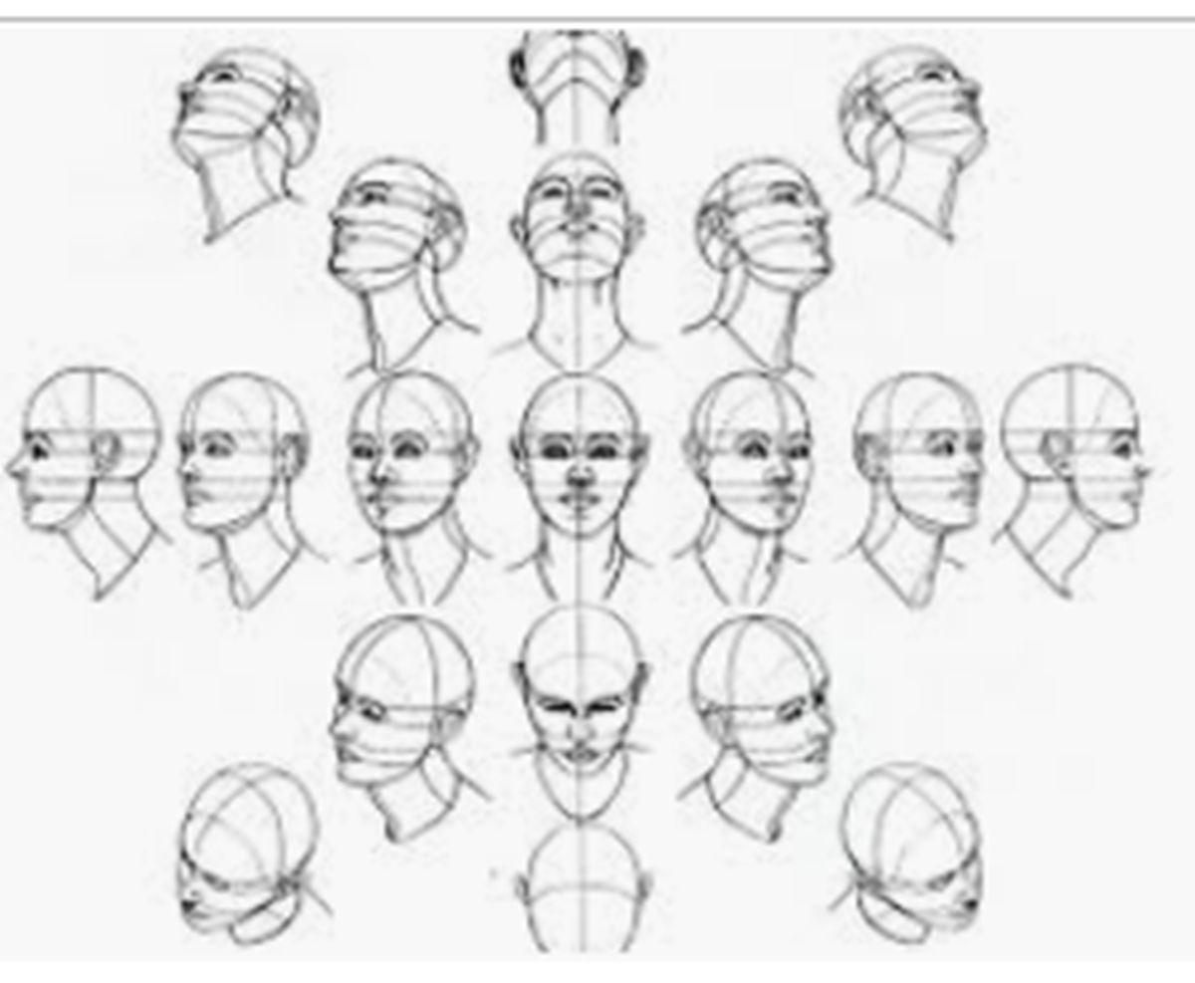

Slide 65
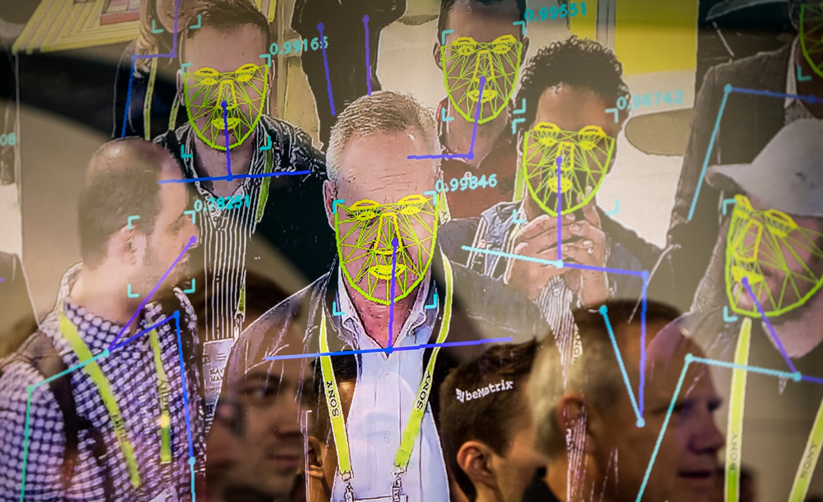

Slide 66

2018 China Image Labeling Factories

Slide 67


Slide 68


Slide 69
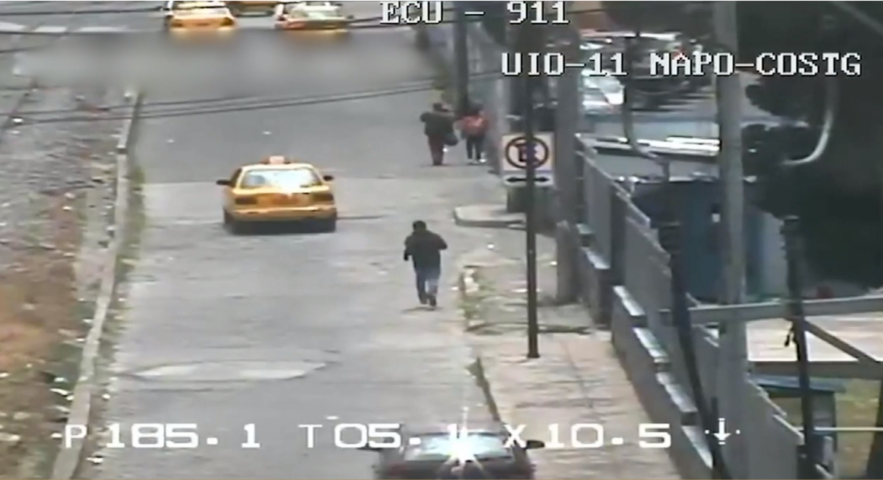

Slide 70


Slide 71


Slide 72
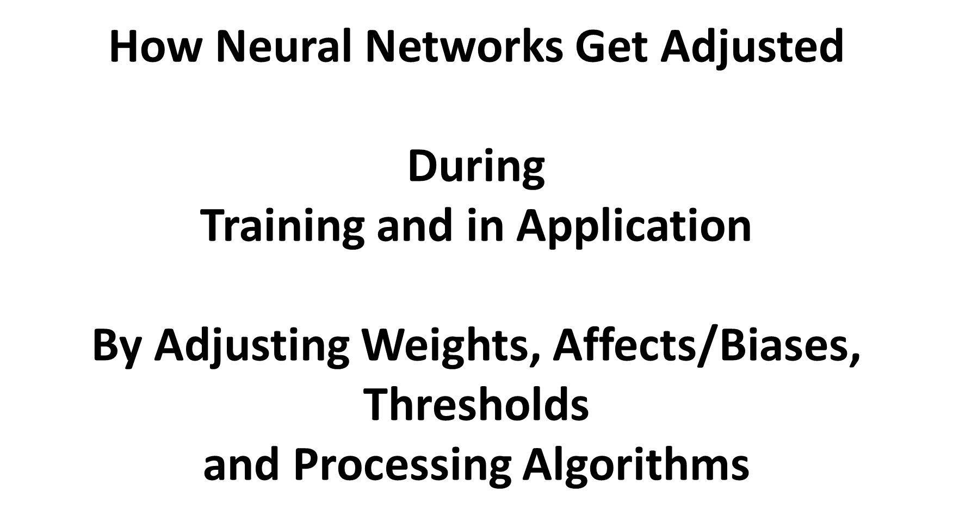

Slide 73
Weights and Thresholds
Weights and Thresholds make the difference between
a basic Conventional Computer Program System and
a Learning Neural Network.
1. The separate Inputs are Weighted,
2. Then calculate the number for the input x the input weight = the weighted input value.
3. Then at each Neuron in a Layer, the separate weighted Inputs are Processed by a Node Function (possibly adding up the Weighted Inputs).
4. This sum is compared to a prescribed (pre-set) Decision Threshold.
5. If the Threshold is exceeded, the Neuron “fires”. Otherwise, It does not “fire”.

Slide 74
The Neurons can adapt to a specific environmental situation
or to deliberately submitted inputs
and adapt “learn” by changing its individual weights and threshold
by the Delta Rule
and by Backpropagation of output error levels achieved by one run and adjusting in anticipation of the next run.

Slide 75
Gradient Descent Learning Rule for updating the weights of the inputs to artificial neurons in a feed forward or single-layer neural network. It is a special
Backpropagation Algorithm where resultant output errors (inaccurate estimates) are fed backward to adjust weights, thresholds and node functions.
3. Gradient descent is an iterative optimization algorithm for finding the minimum of a function.
(finds a local minimum of a function using gradient descent)
4. . If, instead, one takes steps proportional to the positive of the gradient, one approaches a local maximum of that function, known as gradient ascent.

Slide 76

ONE

Slide 77


Slide 78

ONE
Functions and Biases
Calculation Function
Weights
Weights
Output Activation Function
Inputs
Outputs
Calculation Function
Calculation Function

Slide 79

A Single Neural Network Node
Sum the Biased Input Weights
Weights on Inputs
Apply Biases to Input Weights
Processing
2 + 0
+ 7
= 9
9
- 1
= 8
2 = 2
5 = 0
7 = 7
(1 * 2 = 2)
Function f(x)
(0 * 5 = 0)
1* 7 = 7)
Further Processing
Inputs are Weighted (1, 0,1), biased (2,0,7) then Summed (2 +0 + 7 =9) 9-1=8 Activation Threshold
Neuron activates if the final value = the determined Activation Threshold (final step before output)

Slide 80


Slide 81
3-layer Network- Choosing a set of weights ω which minimizes the fitting error
Input
weights
ω_{iq}
Σ_{q}
h_{q}
ω_{qj}
Σ_{j}
y_{j}
S(y_{j})
x_{i}
S_{i}
S_{q}
S_{j}
Output
The problem is essentially “how to choose weight ω to minimize the error
between the expected output and the actual output”
weights
ω_{st} is the weight connecting input s at neuron t
The basic idea is gradient descent

Slide 82


Slide 83

weights
biases

Slide 84


Slide 85

Error Calc.

Slide 86
Overtraining
The Problem of Overtraining a ML System
Maximum Initial Error Level
Worse
Better
Worse
Increasing Degradation
Improvement
Over Trained
Bested Trained Point
Begin Entering
Training Data
Number of Training Cases Analyzed
Should Stop Training Here

Slide 87


Slide 88



Slide 89
The Basic Neuron
Bias
b
x₁
w₁
Activation
function
Local
Field
v
Output
y
Input
signal
x₂
w₂
Summing
function
x_{m}
w_{m}
The Result of the Calculation with the Inputs, Weights, and Biases must exceed a Threshold to Activate
Synaptic
weights

Slide 90


Slide 91
Can we do without an activation function?
1. When we do not have the activation function the weights and bias would simply do a linear transformation.
And is limited in its capacity to solve complex problems.
2. A neural network without an activation function is essentially just a linear regression model. The activation function does the non-linear transformation to the input making it capable to learn and perform more complex tasks.

Slide 92
Without an Activation Function
3. We would want our neural networks to work on complicated tasks like language translations and image classifications. Linear transformations would never be able to perform such tasks.
4. Activation functions - make the back-propagation possible since the gradients are supplied along with the error to update the weights and biases. Without the differentiable non linear function, this would not be possible.

Slide 93

Six Popular Activation Functions

Slide 94


Slide 95

Four Popular Activation Functions
Bias, Tahn, Sigmoid, and ReLU

Slide 96


Slide 97



Slide 98


Slide 99


Slide 100


Slide 101


Slide 102


Slide 103


Slide 104
Sigmoid
Sigmoid is a widely used activation function. It is of the form-
f(x)=1/(1+e^-x)

Slide 105
Sigmoid is a smooth function and is continuously differentiable. The biggest advantage that it has over step and linear function is that it is non-linear. This is an incredibly cool feature of the sigmoid function. This essentially means that when I have multiple neurons having sigmoid function as their activation function – the output is non linear as well. The function ranges from 0-1 (Yes/No) having an S shape. Let’s take a look at the shape of the curve.
The gradient is very high between the values of -3 and 3 but gets much flatter in other regions. How is this of any use?
This means that in this range small changes in x would also bring about large changes in the value of Y. So the function essentially tries to push the Y values towards the extremes. This is a very desirable quality when we’re trying to classify the values to a particular class.

Slide 106
It’s smooth and is dependent on x. This means that during backpropagation we can easily use this function. The error can be backpropagated and the weights can be accordingly updated.
Sigmoids are widely used even today but we still have a problems that we need to address. As we saw previously – the function is pretty flat beyond the +3 and -3 region. This means that once the function falls in that region the gradients become very small. This means that the gradient is approaching to zero and the network is not really learning.
Another problem that the sigmoid function suffers is that the values only range from 0 to 1. This meas that the sigmoid function is not symmetric around the origin and the values received are all positive. So not all times would we desire the values going to the next neuron to be all of the same sign. This can be addressed by scaling the sigmoid function. That’s exactly what happens in the tanh function.

Slide 107



Slide 108
Tanh
The tanh function is very similar to the sigmoid function. It is actually just a scaled version of the sigmoid function.
tanh(x)=2sigmoid(2x)-1
It basically solves our problem of the values all being of the same sign. All other properties are the same as that of the sigmoid function. It is continuous and differentiable at all points. The function as you can see is non linear so we can easily backpropagate the errors.
The gradient of the tanh function is steeper as compared to the sigmoid function. Our choice of using sigmoid or tanh would basically depend on the requirement of gradient in the problem statement. But similar to the sigmoid function we still have the vanishing gradient problem. The graph of the tanh function is flat and the gradients are very low.

Slide 109


Slide 110
ReLU function- Rectified Linear Unit
The ReLU function is the Rectified Linear Unit. It is the most widely used activation function.
It is defined as- f(x)=max(0,x)
The ReLU function is non linear, which means we can easily backpropagate the errors and have multiple layers of neurons being activated by the ReLU function.
The main advantage of using the ReLU function over other activation functions is that it does not activate all the neurons at the same time. What does this mean ? If you look at the ReLU function if the input is negative it will convert it to zero and the neuron does not get activated. This means that at a time only a few neurons are activated making the network sparse making it efficient and easy for computation.

Slide 111

ReLU function- Rectified Linear Unit

Slide 112

Activation at Threshold = 0

Slide 113

TensorFlow
Google System
Graphics Processing Unit

Slide 114
What is TensorFlow?
TensorFlow is an open source software library released in 2015 by Google to make it easier for developers to design, build, and train deep learning models.
TensorFlow originated as an internal library that Google developers used to build models in-house, with additional functionality added to the open source version as they are tested and vetted in the internal flavor.
TensorFlow is the system most choose to use because of its thoughtful design and ease of use.

Slide 115
TensorFlow
TensorFlow is a Python library that allows users to express computation as a graph of data flows.
Nodes in this graph represent mathematical operations.
Edges represent data that is communicated from one node to another. Data in TensorFlow are represented as tensors, which are multidimensional arrays.
TensorFlow is primarily used for Layered Deep Learning (multiple layer Neural Networks) in practice & research.
4. Representing deep learning neural networks in this way allows us to take advantage of the speedups afforded by modern hardware (i.e., IBM 256 GPU acceleration)

Slide 116
TensorFlow (Google) is system which has two basic components.
a library for defining computational graphs- a way of describing computations as a directed graph, a data structure consisting of nodes and connecting edges. It’s a set of vertices connected, two at a time, by direct links or “edges”.
2. a runtime program which executes the graphs on a variety of different hardware

Slide 117
A simple example of such a TensorFlow graph program is:
1. a = 14
2. b = 4
3. product = a * b
4. sum = a + b
5. result = product / sum
6. Output (result)

Slide 118

Input connected over link a
product = a * b
Tensors
14
result = product / sum
Result – Output to Print
4
Input connected over link b
Sum = a + b

Slide 119
Example Code for TensorFlow Connected Graph Processing Program
1. import tensorlow as tf
with tf.Session ( ) as sess:
3. # Phase 1 : constructing the graph
4. a = tf.constant (14, name = “a” )
5. b = tf.constant (4, name = “b” )
6. product = tf.multiple (a, b, name = “Multiply”
7. sum = tf.add (a, b, name= “Add”)
result = tf.divide (product, sum, name= “Divide”)
9. # Phase 2 : run the program “TensorFlow Example”
10. Output = sess.run (result)
11. Print (out)

Slide 120


Slide 121


Slide 122

Industries and Uses
Analyzing Blobs of Text
Finance, Social Media, CRM, Insurance, detect insider trading, regulatory compliance, brand affinity, sentiment analysis and intent analysis.
Security- Voice Recognition, voice analysis, CRM- sentiment analysis, Auto/Air- engine and instrument flaw detection. Credit card fraud detection
Data Center Log Analysis, risk fraud detection, Supply Chain resource planning, predict analysis with censored data. Social Media and e-commerce building Recommendation Engines
Security- facial recognition, social media tagging and identifying people in pictures,

Slide 123


